Slide 1
Social Media Workshop
CATSC Conference 2017
Notes:
6th Feb 2017
Genesis 1:3
'Let there be light,'

Slide 2
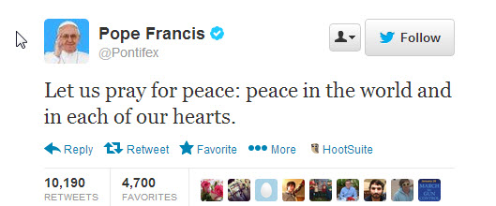

Slide 3
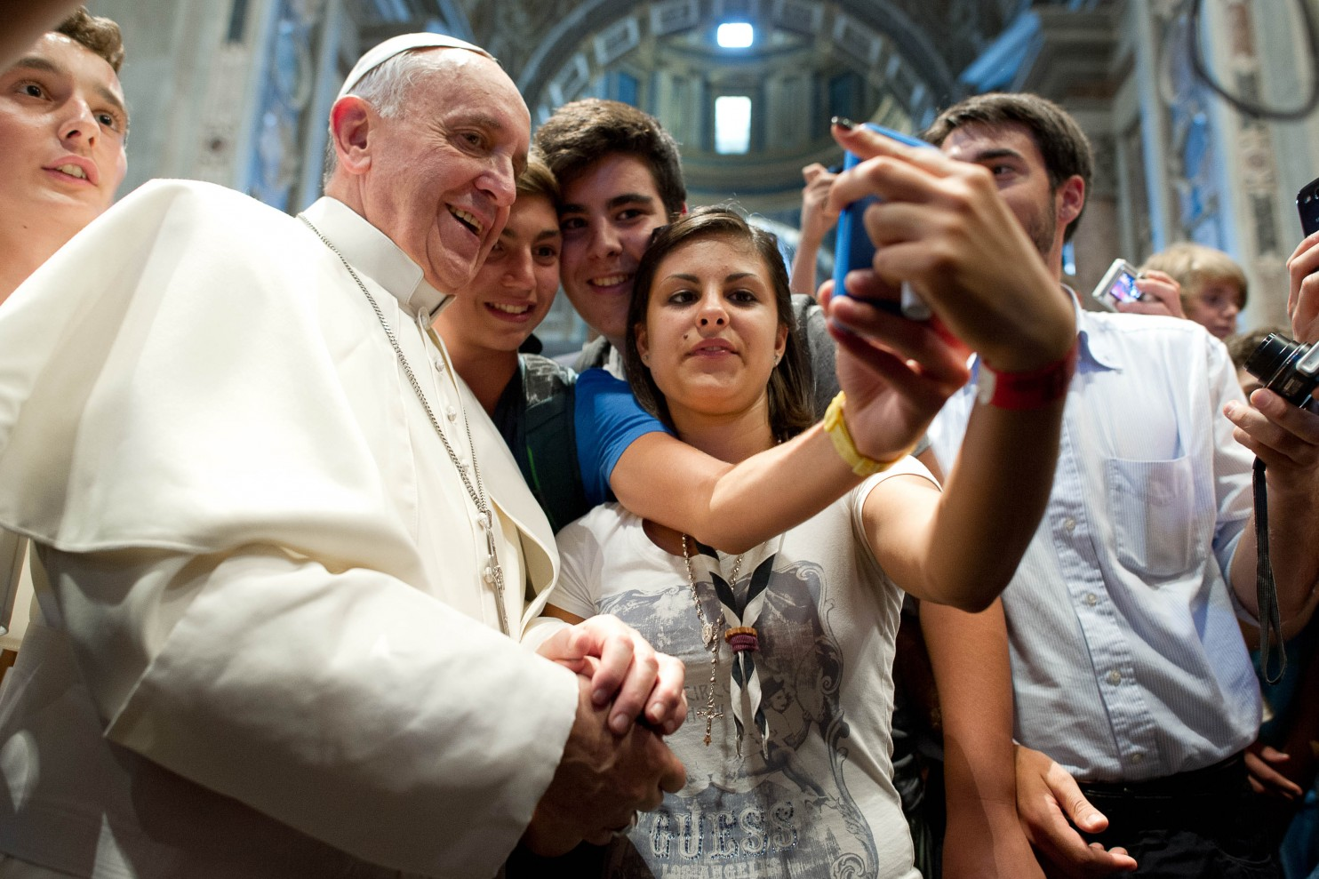

Slide 4
Some social media statistics
Notes:
Social media with youth, parents an community.
POSITIVE OUTCOMES FROM SOCIAL MEDIA.

Slide 5
The internet has 3.17 billions users
Internet users have an average of 5.54 social media accounts
1 million new active mobile social users are added every day.
That’s 12 each second
Facebook Messenger and Whatsapp handle 60 billion messages a day
Facebook now sees 8 billion average daily video views from 500 million users
Snapchat users watch 6 billion videos every day
There are 500 million Tweets sent each day. That’s 6,000 Tweets every second

Slide 6
The CATSC Dailies

Slide 7
Yahweh our Lord, how majestic your name throughout the world!
Psalms 8:9
7th Feb 2017
Notes:
7th Feb 2017
Psalms 8:9
Yahweh our Lord, how majestic your name throughout the world!

Slide 8
Psalms 104:30
You renew
the face
of the earth
8th February 2017
Notes:
8th Feb 2017
Psalms 104:30
You renew the face of the earth.

Slide 9
I will shower
blessings on you.
www.catsc.org

Slide 10
King of Peace
Hebrews 7:2
www.catsc.org

Slide 11
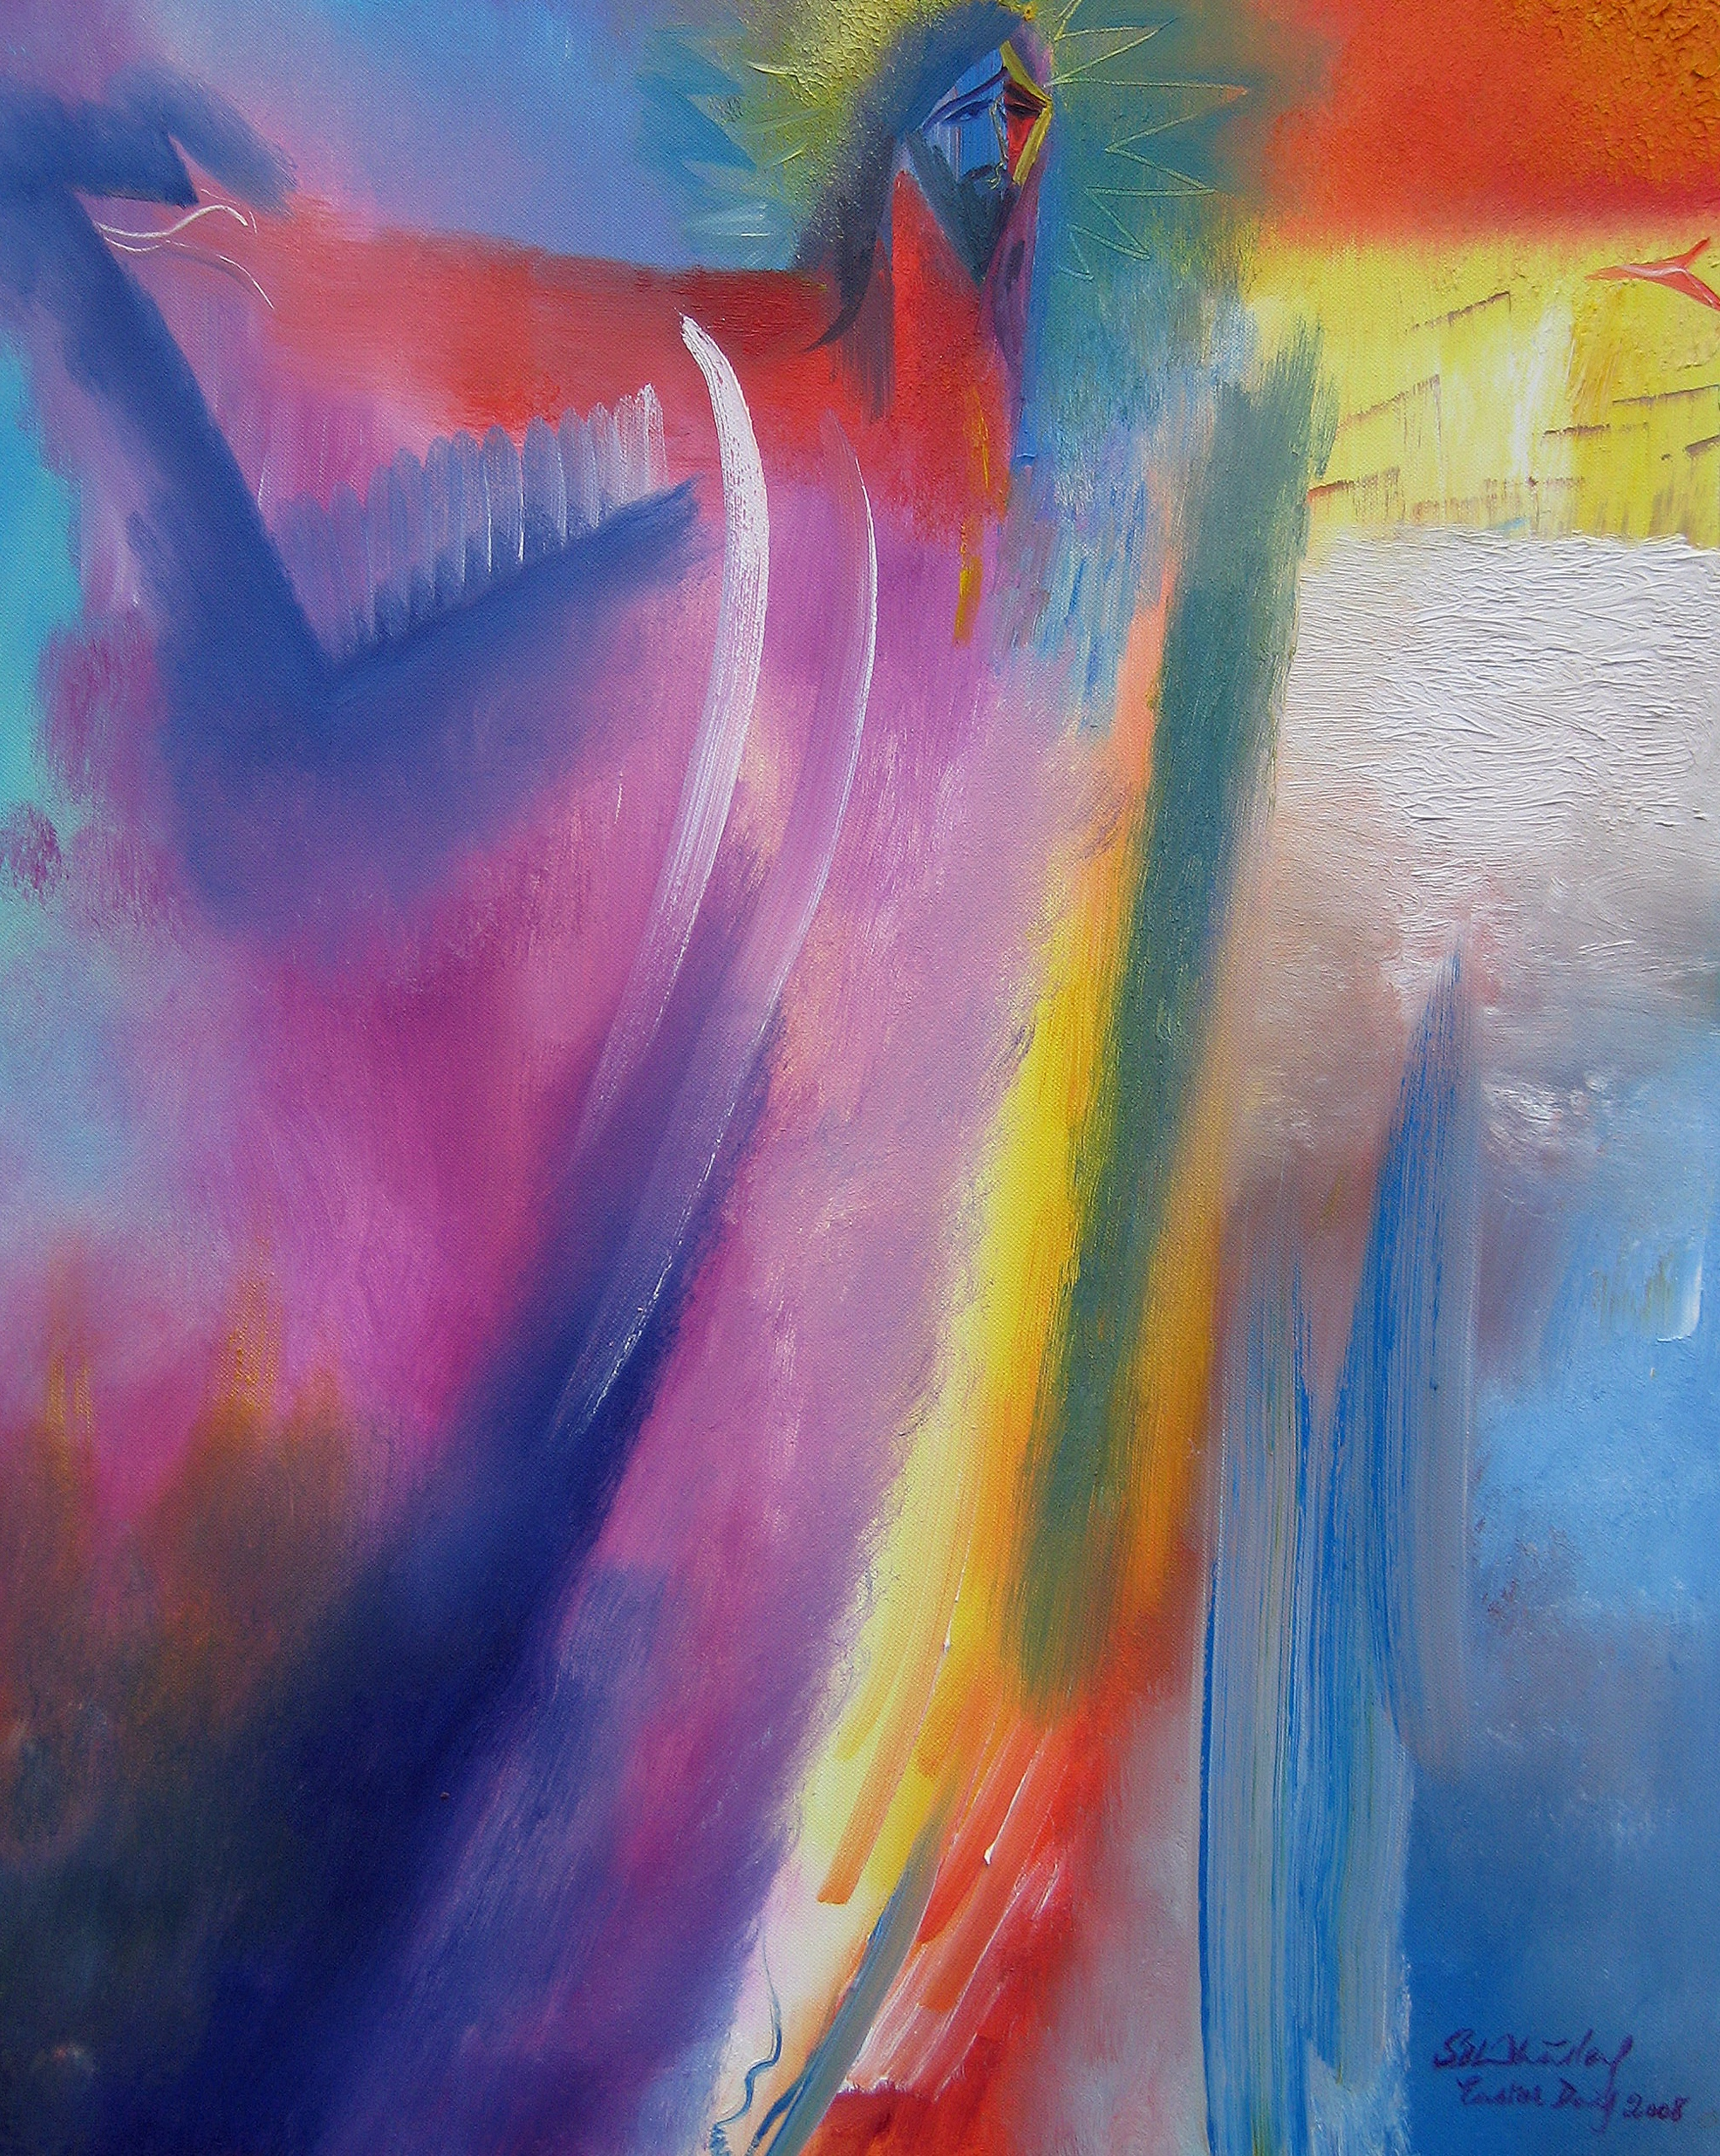
Mark 3:11
'You are the Son of God!'
www. catsc.org

Slide 12
Catholic Association of Teachers, Schools and Colleges
“His glory will dwell in our land” Psalms 85:9
Notes:
his glory will dwell in our land

Slide 13
Father, Son and Holy Spirit.
We praise you and give you glory.
www.catsc.org
Notes:
9th Feb 2017
Daily prayer
Father, Son, and Holy Spirit, We praise you and give you glory.

Slide 14
Everything he does is good
10th Feb 2017
Mark 7:37
Catholic Association Of Teachers, Schools and Colleges
Notes:
10th Feb 2017
Mark 7:37
Everything he does is good

Slide 15
Remember…
Ash Wednesday 2017
you are dust
and to dust
you will return.

Slide 16
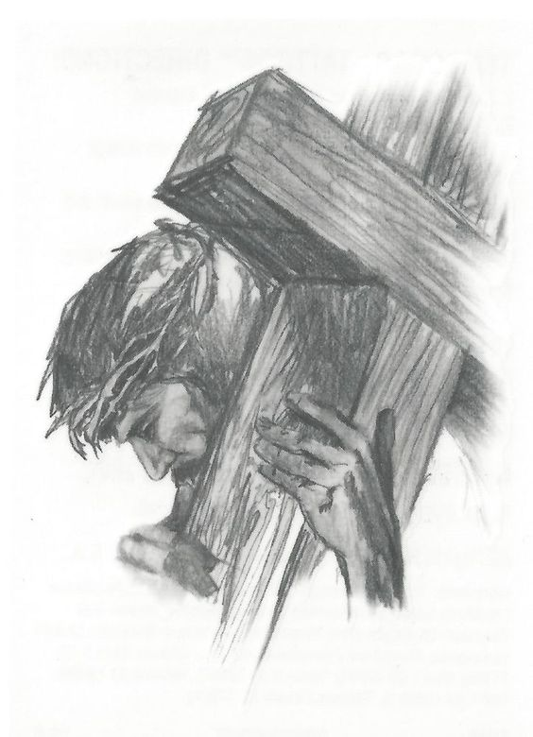
Take up
2nd March ‘17
His cross
everyday
Luke 9
www.catsc.org
Notes:
2nd March 2017
Luke 9
Take up His cross everyday

Slide 17
LOVE IS PATIENT
love is kind
love is not jealous
IT IS NOT
or boastful
ARROGANT
believes all
OR RUDE
things
St. Valentine’s Day 2017
LOVE BEARS ALL THINGS
HOPES
endures all things
all things
LOVE NEVER ENDS
1 Corinthians

Slide 18
With the Lord on my side
Psalms 31:24
I fear nothing.
www.catsc.org
30th January 2017
Notes:
30th Jan 2017
With the Lord on my side, I fear nothing.
Psalms 31:24
Be brave, take heart, all who put your hope in Yahweh.

