Slide 1
CATSC
STUDY CONFERENCE
Saturday 4 March 2017
…Called to be missionaries
of the Gospel…
Notes:
It is good to be here ! AND a really amazing privilege for me to being giving the Damien Lundy lecture. I worked with Damien closely for a period of 3 years…along with Jim Gallagher…writing ICONS the R.E. programme for KS3.
It was super…he was a delightful man to be with, as well as an inspiring theoligan, speaker and writer.
SO, A REALLY BIG THANK YOU!
Let me tell you a joke to begin !! THE FARMER AND HIS DOG
Our presence here is evidence of something very distinctive – our reason for being here is to reflect on that and celebrate it.
LET’S NOT MISS THE POINT !!!
The Thesauras tells us that MISSIONARIES ARE:

Slide 2
MISSIONARIES... disciples... Followers... messengers...
GOSPEL...
Certainty...fact..truth...good news...
the last word !
Notes:
That Gospel – that Good News...that Last Word....is our vision...our raison d’etre....our purpose is to announce it...live it...embody it.,

Slide 3
GOOD NEWS
and
how it
MUST IMPACT
(shape;mould;influence;form)
in our schools.
Notes:
So, what I want to do during this session is share my understanding of that GOOD NEWS and how it impacts MUST IMPACT in our schools...
AND HOW YOU, AS TEACHERS , UNDERSTAND IT, OWN IT, ENABLE, ESTABLISH THE SYSTEMS AND STRUCTURES TO IMPLEMENT IT....
SO, I WANT TO DO 4 THINGS ( i TALK FAST!!)_

Slide 4
4 THINGS:
I want to share a key aspect of that Good News...
2. ...and how it might be experienced in your schools...
3... I want to look at the challenges - external and internal - of our culture as we try to make
the vision a reality...
4. ...And then, to reflect briefly on your role as teachers in this mission and ministry.

Slide 5
What is it that we have to proclaim...
What’s the message?
Notes:
Just for a brief moment or two...just try and articulate that message?
BUZZ !!
Get some feedback...just a few ideas...
THERE’S A DANGER THAT THE MESSAGE IS SO BIG THAT WE END UP MISSING ITS CORE...MISSING ITS CENTRALITY TO EVERYTHING THAT WE SAY OR DO...OR WE SELCT THE BITS OF THE MESSAGE THAT FITS OUR OWN EXPECTATION AND UNDERSTANDING....
I HAVE THE MESSAGE TO A ‘T’.... It comes from over 40 years of involvement in Catholic education at all levels and considerable reflection!

Slide 6
“ I HAVE COME THAT YOU
MAY HAVE LIFE…
AND
HAVE IT TO THE FULL” . John 10:10
Notes:
It is NOT values ( inclusivity, diversity, tolerance, social justice, EVEN Not British Values !!! ) OR DARE i SAY ‘GOSPEL VALUES’ THAT MAKE US DISTINCTIVE
They are essential to it but do not define it_
WHAT MAKES US DISTINCTIVE IS …. FAITH…RELIGIOUS FAITH…CATHOLIC FAITH…..FAITH IN JESUS CHRIST - THIS IS OUR VISION
It is this that makes it distinctive from secular education in which this religious dimension remains unacknowledged.
I want to look at this VISION through two metaphors….apologies but I just couldn’t limit myself to one !
I want to break it down and share reflect on the components of the vision…BUT…keep the vision in MIND:
“ Life to the full”
I ALSO WANT TO LOOK AT THE EXTERNAL AND INTERNAL FACTORS WHICH AFFECT THAT VISION...IMPACT ON IT.

Slide 7
FIRSTLY:
What does it mean to have
‘life to the full’ ?
Notes:
So, I want to share with you a view of what it means to be fully human and what the challenge is for us as disciples, followers...missionaries...

Slide 8
KEY FOUNDATION STONES upon which Catholic education is built
A shared vision of life
God is at the heart of our world;
A vision of the human person.
The partnership between home, school and parish.
The ethos of the Catholic school
The Rich Tradition of the Church in education.
The richness of our heritage.
The curriculum is both whole and holy.
Everything ultimately comes from God.
The truth of each curriculum area is respected.
Religious education is at the heart of the curriculum
We are who we say we are
Mission Statement and Policy Documents.

Slide 9
A
VISION…
A SIGHT FOR SORE EYES…
Notes:
The therasus defines ‘VISION’ as a sight for sore eyes and in our present educational climate that rings true for me…who knows tomorrow ( or even what they said over half –term, that teachers are now responsible for !
Our world too - with so much sadness and war and injustice – can cause us to have sore eyes…eyes that need to see in a different way, through a different lens…

Slide 10

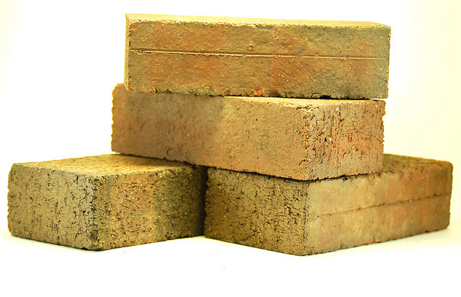
Mixing metaphors !!
A VISION OF
THE
HUMAN
PERSON
MAKING IT REAL !
GOD AT THE HEART OF OUR WORLD
From a CATHOLIC PERSPECTIVE
From a
CATHOLIC
PERSPECTIVE
MAKING IT REAL !
OF THE
HUMAN
PERSON
GOD
AT THE HEART OF
OUR WORLD
VISION
Notes:
THESE ARE THE PARTS OF THE WHOLE –
The jigsaw…fitting together to give the whole picture….each one contributing to the bigger picture… IT DOESN’T MAKE SENSE WITHOUT ALL THE PARTS.
the building…with the foundation stones upon which the school is built….
We need them all…one follows on from the other.

Slide 11


GOD -
GOD
…at the heart of our world…
Catholic education is an encounter with God, which makes it distinctive from secular education which does not acknowledge this dimension
…FAITH – RELIGIOUS FAITH is what marks us out as distinctive.
…this central belief helps to create a disposition of receptivity to how things really are…because the message we are receiving elsewhere is that this is it…this is all there is, so use it NOW.
Notes:
OUR SCHOOLS SHOULD BE PLACES WHERE WE ARE LIBERATED FROM CLOSED IDEAS OF GOD.
THERE IS A GOD AT THE HEART OF OUR WORLD.
Our relationship with God is hopefully something which is growing….
Sometimes parents can resist relating to their grown children as adults…similarily we can ‘frame freeze’ God in an image or understanding we adopted at one stage of our lives…but is now inappropriate and incapable of nourishing us today.
We want in our schools to open our pupils up to the presence of God in all things.
It is God who calls us into being – it is God who invites us into a relationship with him/her and the world we are part of; it is God as Father who shows us in Jesus what it means to be fully human… GOD IS AT THE HEART OF ALL THAT WE DO.

Slide 12
GOD

Slide 13
In a Catholic school, and analogously in every school,
God cannot be the Great Absent One
or the unwelcome intruder....
One of the characteristics of a Catholic school is that it interprets and gives order to
human culture
in the light of faith.”
The Religious Dimension of Education in a Catholic School. Rome 1988 n.52

Slide 14
Privilege & Responsibility
“ Catholic schools and Colleges
have a distinctive
educational philosophy and purpose
based on a specific religious understanding
of the nature of the human person
and the role of the
Catholic Church in society.”
Notes:
This is a tremendous privilege – we have great freedom to pin our colours to the mast…
It equally has responsibilities…those will follow in a moment, but just reflect for a minute on the reality of the fact that we have a vision of the fully alive human person to guide us in our educational provision.
IT IS NOT VALUES THAT MARK US OUT…IT IS FAITH
WE ARE MUCH BETTER PLACED TO TALK ABOUT COMMON VALUES THAN THE GOVERNME

Slide 15


A VISION OF THE HUMAN PERSON
HUMAN
PERSON
VISIONARY
SACRAMENTAL
RELATIONAL
TRANSFORMATIONAL
Notes:
SO WHAT IS THIS VISION OF THE HUMAN PERSON
WHAT WILL REALLY CHANGE OUR WORLD IS NOT THE ECONOMY ONLY….BUT …HUMAN FLOURISHING.
Made in the image of God having fundamental freedom and dignity
We want to enable life to the full….much more than just ensuring we have the basic necessities of life.
I BELIEVE THERE ARE 4 KEY COMPONENTS TO WHAT MAKES A FULLY ALIVE HUMAN BEING>>>

Slide 16
VISIONARY
Notes:
TO BE FULLY HUMAN IS TO BE VISIONARY.
TO HAVE A DREAM…NOT A FANTSTY…BUT A DREAM OF WHO I CAN BE…
Looking to the ‘beyond’ that the material world and technology alone cannot give
God has a dream for us…
WE LIVE IN A WORLD THAT SAYS HAVE THIS, HAVE THAT AND YOU WILL BE HAPPY, BE SUCCESSFUL, BE WHO YOU ARE MEANT TO BE….BUT NO…
YOU CAN HAVE ALL THAT AND STILL NOT HAVE A SENSE OF WHO YOU REALLY ARE.
The eagle and the backyard hen…

Slide 17
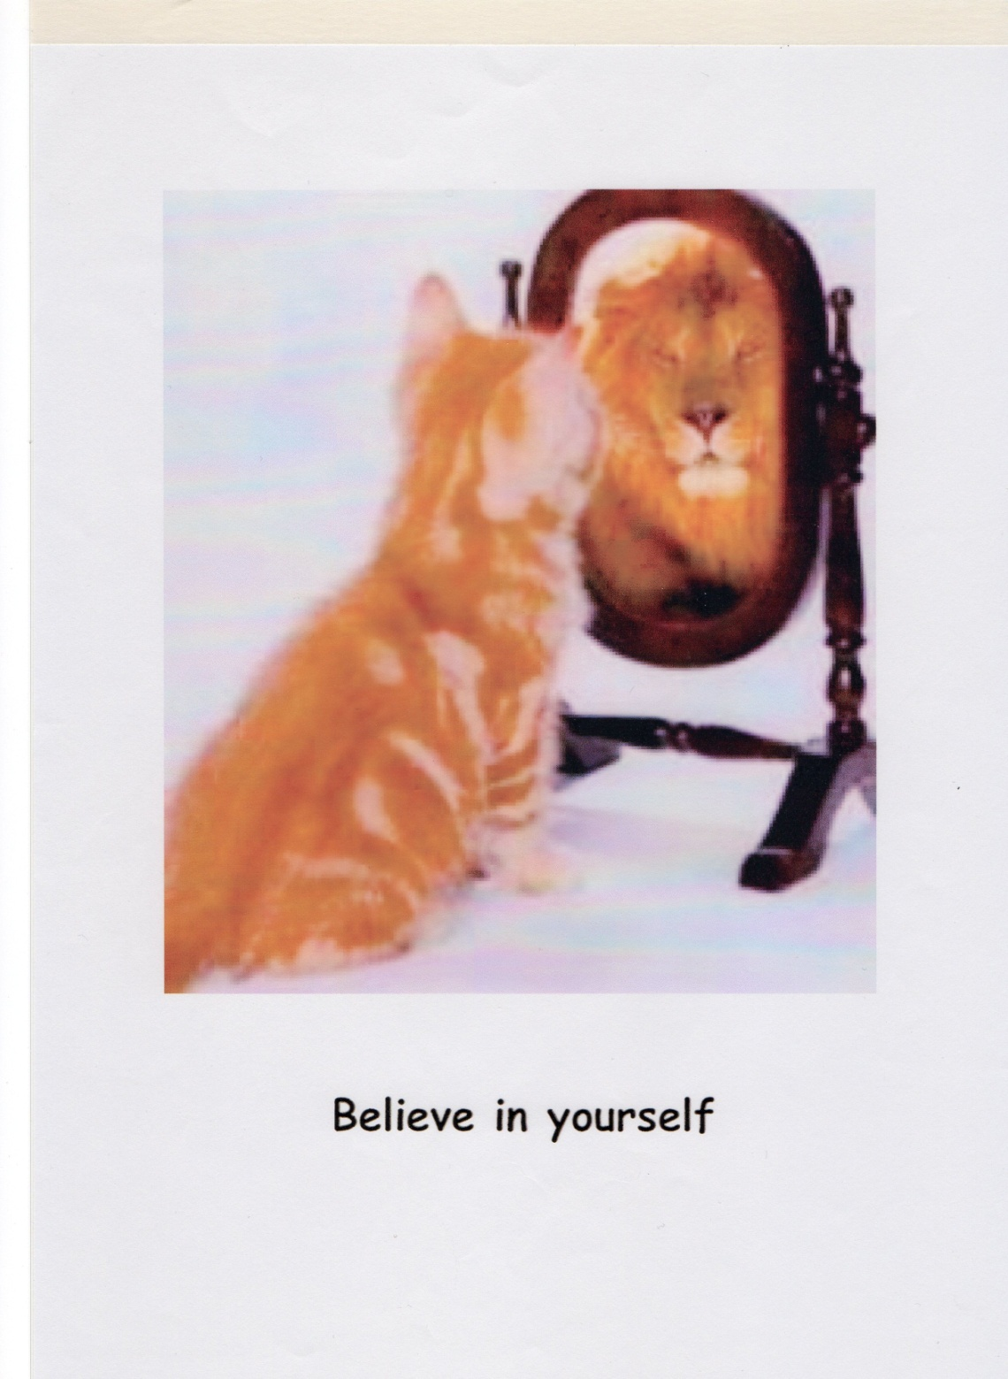
Notes:
Many of our youngsters come to school already damaged…think they are no good, stupid, not as bright, as pretty , as good looking…because….we live in a world of superficial reality…what you see is who you are and what you get !
THERE IS MORE TO ME THAN MEETS THE EYE…THERE IS MORE TO YOU THAN WHAT OTHERS SEE.

Slide 18
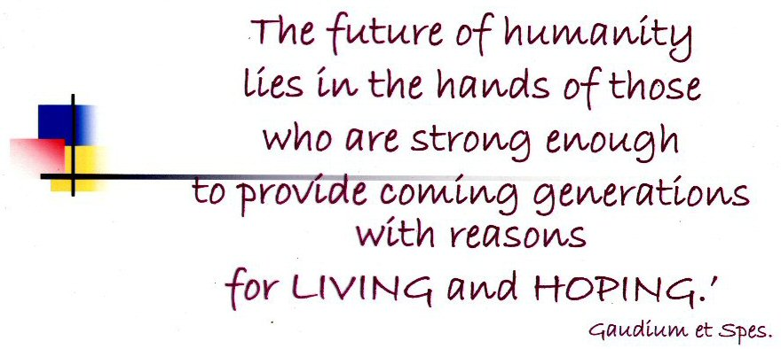
Notes:
WHAT WE ARE CHARGED WITH GIVING OUR YOUNSTERS IS….
REASONS FOR LIVING AND HOPING !

Slide 19
SACRAMENTAL
Notes:
TO BE FULLY HUMAN IS TO BE SACRAMENTAL….TO GET BENEATH THE SURFACE…TO READ THE SIGNS….
Nurturing a sacramental sensitivity should be at the heart of Catholic education
We live in a world, a society that sees everything as makeable / useful/ immediate and often without deeper meaning. Buy this, have this, wear these designer shoes and you will BE IT !! You will be recognised, acknowledge, valued because you have it !
Do not think any of us is not influenced by the power of adverts – renault clio and Nicol !!
Education – Catholic education – must take our pupils beneath the surface to what lies below…beyond the tangible…
A RING IS NOT JUST A ROUND PIECE OF METAL, HOWEVER EXPENSIVE…IT IS A SIGN OF LOVE, OF ETERNTIY…OF FAITHFULNESS…OF COMMITMENT.
WATER IS MORE THAN HO 2….WATER IS POWER AND DANGER AND LIFEGIVING AND DEATH AND DESRTUCTION …
A BOTANIST DOES NOT JUST LOOK AT A FLOWER AND ANALYSIS IT…IT IS BEAUTY…IT IS ALIVE…IT IS AWE-INSPIRING.
We need to create a disposition of receptivity to how things REALLY are !
Nurturing a sacramental sensitivity should be at the heart of Catholic education
We live in a world, a society that sees everything as makeable / useful/ immediate and often without deeper meaning.
We need to create a disposition of receptivity to how things REALLY are !
Nurturing a sacramental sensitivity should be at the heart of Catholic education

Slide 20
…some of the language of faith…
Gloria; Good Life;
Paradise; Pure; Miracle; Truth; Angel; Salvatore;
Soul; Sacrifice; Heaven; Eternity; Devil; Hope;
Faith; Zeal.
Notes:
WE MIGHT BE FORGIVEN FOR THINKING THAT OUR PUPILS KNOW THAT…KNOW THE MEANING OF THE SPIRITUAL DIMENSION OF LIFE BUT I WOULD CHALLENGE THAT….
BEING ABLE TO USE RELIGIOUS WORDS, RELIGIOUS LANGUAGE DOESN’T MEAN WE UNDERSTAND IT… LET ME GIVE YOU AN EXAMPLE
What do these words speak about ?
They are all the names of a product on the market today!
THE WORD IS PERFUME !!
THE CHALLENGE – HOW to speak to young people of FAITH in the current Culture….clashing symbols

Slide 21

Notes:
THIS IS THE CURRENT CULTURE – IT IS NOT BLACK POR WHITE BUT I USE THIS AS AN EXAMPLE OF IT….
THIS IS WHAT OUR SOCIETY SAYS ARE THE IMPORTANT THINGS IN LIFE !! AND OBVIOULDY IF YOU HAVEN’T GOT ACCESS TO THEM, WELL…YOU’VE LOST SO GET TO AND GET THEM…BECAUSE THIS IS IT!
THIS IS THE REAL ….

Slide 22
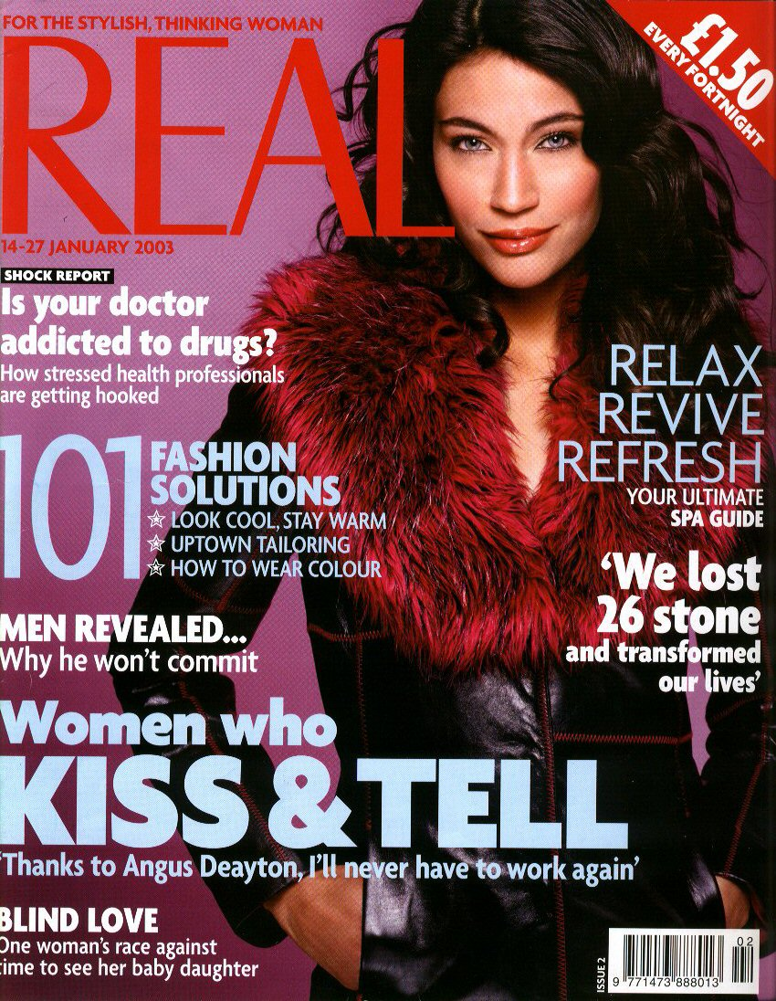
Notes:
Consumer approach to life – we will just pick bits of what we fancy…I SHOP THEREFORE I AM !
I AM WHAT I MAKE OF MYSELF
We want to educate young people of depth…not of superficiality
The superficiality of depth get in the way of a personal encounter with God….superficiality enables us to skim the surface of life…a reduced mentality.
Understanding the sacramentality of life can enable us to address this culture of superficiality.
We need to expose young people to questions of meaning and purpose…
WE MUST PREPARE them for a READINESS FOR DEPTH - I SAY IT AGAIN !
THE CHALLENGE – HOW to speak to young people of FAITH in the current Culture….clashing symbols

Slide 23
relational
Notes:
You cant define me as a person by the nature AND FUNCTION of who I am: I eat, think, walk and do a lot of things, but that does not make me ‘me’.
I am more than a biologcial set of facts.
What makes me fully human is the way I interact with other people…in my life I am surrounded by a network of relationships and they help define who I am.
This is the mysterious nature of what it means to be a person…this relationship element that is key to our humanity doesn’t change whether we are young old disabled, dying or on the margins of society.
Christians believe that attention and respect is due every person because we are all caught up in this relational reality.
We are fully human in and through our relationships….

Slide 24
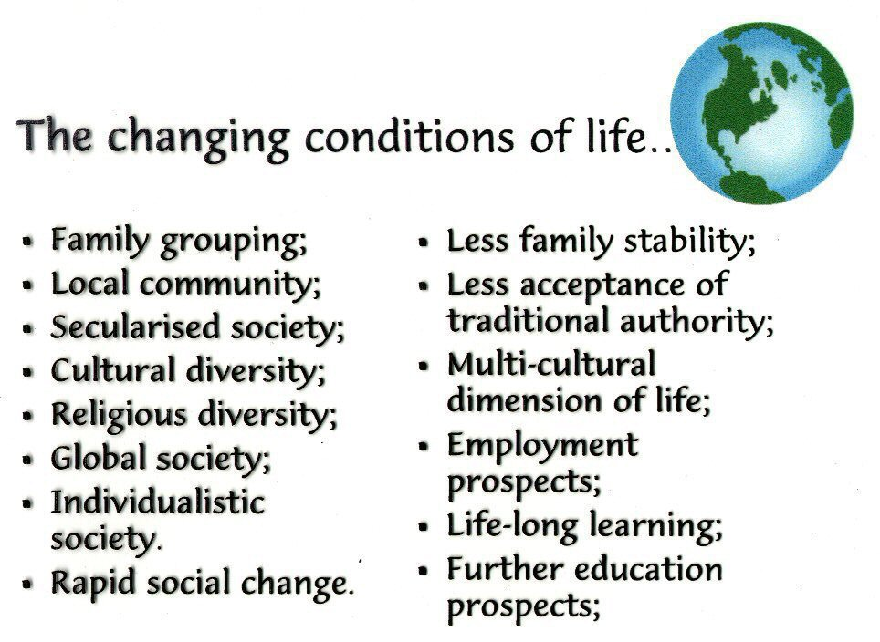

Slide 25
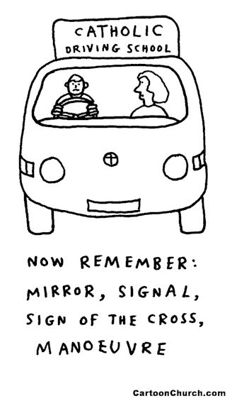
Certain behaviours are expected

Slide 26
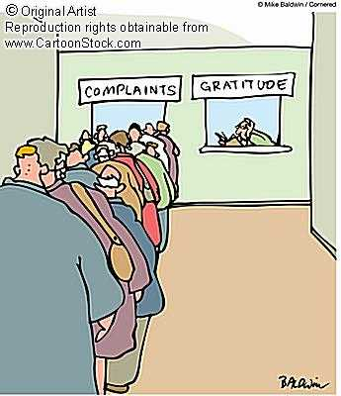

Slide 27
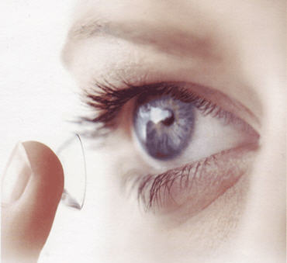
Anam Cara – John Donoghue
To the inferior eye, everything is greater
To the resentful eye, everything is demanding
To the controling eye, everything is a threat
To the greedy eye, everything is expensive
To the possessive eye everything is desirable
To the cautious eye, everything is a risk
To the demanding eye, everything is a disappointment
But to the grateful eye, everything is a blessing
Notes:
IT IS THE ELNSE THROUGH WHICH WE VIEW THE WORLD....IT AFFECTS ALL ASPECTS OF HOW WE LIVE...

Slide 28
TRANSFORMATIONAL
Notes:
TO BE FULLY HIUMAN IS TO BE TRANSFORMATIONAL….
GOD HAS NOT FINSIHED WITH ME YET ! I AM NOT FULLY THERE…AND THE OLDER I GET THE MORE I REALISE THAT !
YOURE NOT THE FINISHED THING EITHER….SO….LETS BE AWARE THAT OUR YOUNG PEOPLE ARE IN THE EARLY STAGES OF THEIR GROWTH AND DRVELOPEMENT!
THERE IS STILL TIME !
CATHOLIC Education : inspires hearts; facilitates minds; stimulates immagination; raises spirits; encourages hope; access wisdom.

Slide 29
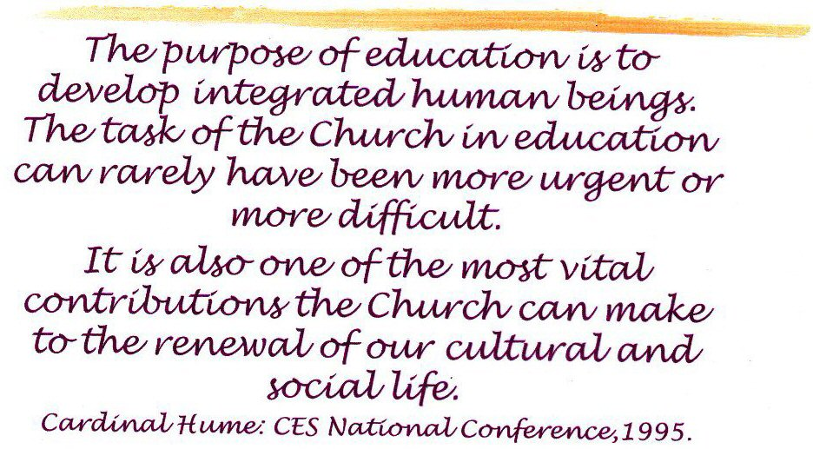
Notes:
IT TAKES QUITE A LIFETIME TO CREATE A FULLY ALIVE HUMAN BEING !!

Slide 30
A FULLY ALIVE HUMAN PERSON...
TRAINING THE EYE...
CULTIVATING THE CONTEMPLATIVE...
BEING DRAWN TO THE PRESENT MOMENT...
TRAINING THE HEART...
Notes:
WE ARE FORMING MINDS TO UNDERSTAND REALITY....HOW DO WE GET THE WHOLE PICTURE OF REALITY BECASUE WE ALL SEE THINGS FROM OUR OWN PERSPECTIVE...LIMITED...THE THREE BLIND MEN AND THE ELEPHANT...
WE Want to take in the whole picture...a person is more than his/her sexuality...more than his/her gender...a flower is more than how a botanist would classify it...water is more than HT0...
WE NEED TO TRAIN THE EYE – WHAT IS THE ‘EYE’ WE ENABLE, DEVELOP IN OUR SCHOOLS? How do we see...how do we look at the world?
WE ARE TRAING THE EYE SO THAT REALITY IS NOY DISTORTED...OR IMPOVERISHED.
We need to cultivate the contemplative...to sit back, listen, smell...be drawn into the present...TO MOMENTS OF SILENCE.
WE NEED TO BE AWARE OF WHAT IS GOING ON IN OUR HEARTS...WHERE OUR FEARS RESIDE...OUR DECISIONS ARE BEING TAKEN...WE NEED TO BE AWARE OF WHAT IS GOING ON IN OUR HEARTS....THE SEAT OF MY PERSONALITY...WHERE MEMORIES RESIDE...VOICES ARE HEARD...FEELINGS ARE FELT AND EXPERIENCED.
WHAT IS THE QUALITY OF OUR HEART?

Slide 31

TRAINING THE EYE...
The eye is the lamp of the body; so then if your eye is clear, your whole body will be full of light. But if your eye is bad, your whole body will be full of darkness. If then the light that is in you is darkness, how great is the darkness!

Slide 32

The Heart
Seat of my personality
Receives stimuli: sensory perceptions, memories, “voices”, desires, feelings, promptings…
Issues a response

Slide 33
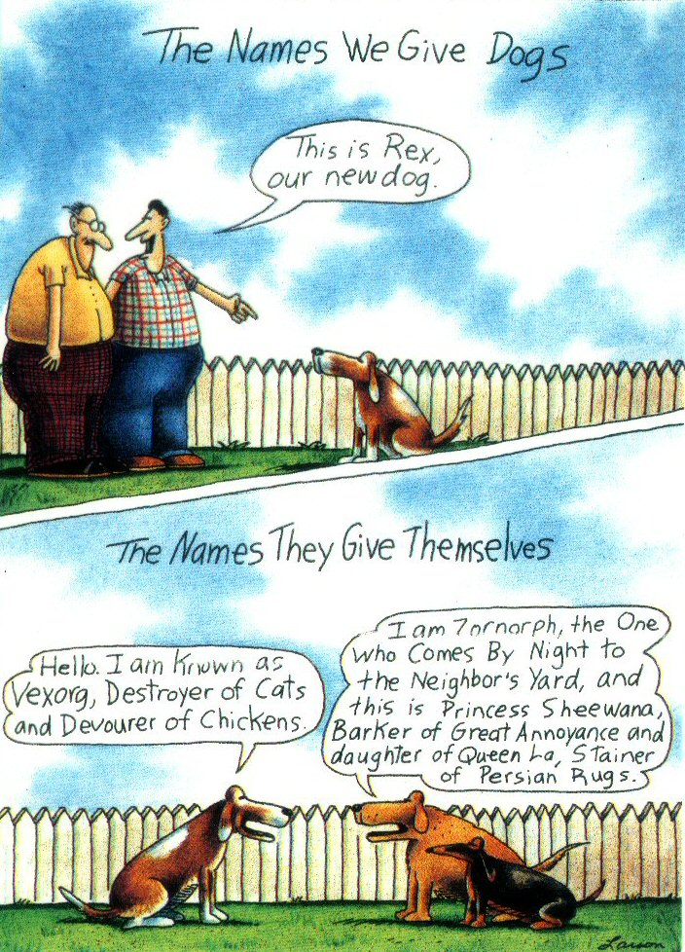
Notes:
AND, JUST IN CASE YOU THINK YOU’VE GOT IT SORTED…WHAT WE SAY AND THINK ABOUT OUR PUPILS CAN BE SOMEWHAT DIFFERENT TO WHAT THEY SAY ABOUT THEMSELVES !!

Slide 34
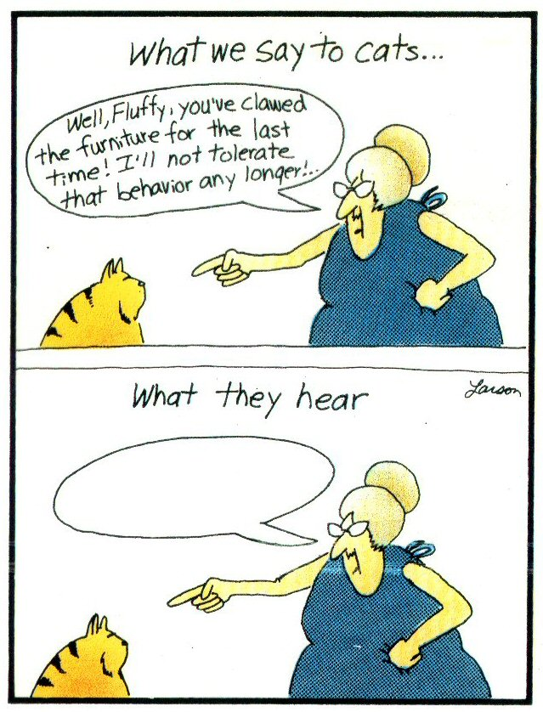
Notes:
AND - SOMETIMES THEY DON’T EVEN HEAR WHAT WE SAY !!

Slide 35
Pope Benedict XVI.
Twickenham 2010
“The task –
is not simply to impart information or to provide training in skills intended
to deliver some economic benefit to society;
Education is not
and must never be considered as purely utilitarian.
It is about forming a human person,
equipping him or her to live life to the full”

Slide 36
QUESTION:
WHAT about this vision inspires me... is in tune with my own thinking...?

Slide 37

SECONDLY
How might this vision be
experienced
in school?

Slide 38

Notes:
NOR IS IT SOMETHING THAT CAN BE SPRAYED ON….
NO – IT MUST BE EXPERIENCED DAY IN AND Day OUT…

Slide 39
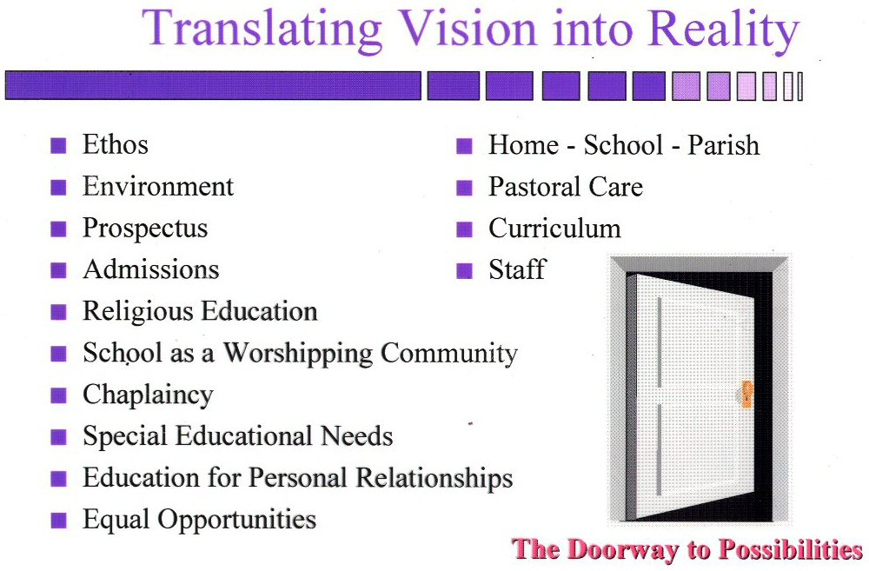
Notes:
IT MUST BE EVIDENT IN ALL THAT WE DO AND SAY AND PRACTICE…

Slide 40
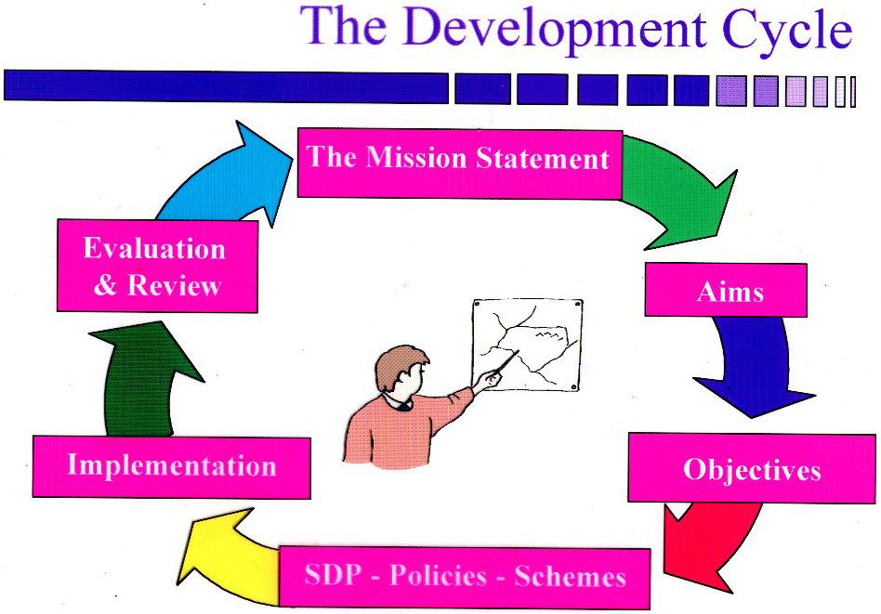
Notes:
It starts with how we express this vision for our own school, in our own words….and filters through to every aspect and dimesnion of how we operate as Catholic schools

Slide 41
Visionary
Pastoral care…the integration of all that we do…
Every child matters…
Education for personal relationships…
The celebration of success…
The celebration of ‘difference’…
The approach to all areas of special needs…
The opportunities for developing responsibility…
The respect and value for the individual...
The Common Good – human flourishing…
Pastoral care…how we look after and look out
for our children… teacher expectations;
Relationship and sex education…about
themselves…others…in relationship to each
other;
Special educational needs…for all, especially
those in most need;
Equal opportunities…what is offered, made
available, believed to be a right….
Human flourishing…how talents and gifts are
recognised, celebrated, developed.
Notes:
AND IT IS NOT JUST FINE WORDS….IT HAS TO BE EXPERIENCED IN ALL ASPECTS OF EVERYDAY LIFE IN SCHOOL….TOUCHED, TASTED, HEARD, SPOKEN AND SENSED.

Slide 42
Sacramental
The curriculum…the richness of the curriculum…its depth…its inter-connectedness;
The sacramental life of the school…how the school sees itself to be Catholic…liturgy…prayer…the widest range of opportunities;
Spiritual and moral development…there is more to life than meets the eye…develop depth…respect themselves and others…know what is right and wrong;
Home, school, parish links…a shared understanding of what the school is about…engaging with the ‘family’…experiencing partnership.
The breadth and the depth of the
curriculum…English; maths, science…
The awareness and recognition of the
beauty within each subject area…
The development of the spiritual
dimension of life…
The opportunities taken and planned
for moments of reflection
Spiritual and moral
development…across the whole
curriculum
Links with home and parish…

Slide 43
Relational
Relationships…respect for self and for others
Behaviour…expectations and rewards and sanctions
The Common Good…the call to wholeness and to be of service to others
Social and cultural development…how the school engages with its neighbours, local, national and global; the richness of diversity.
How pupils behave towards each
other…how staff behave towards
each other…and pupils…
How bullying is dealt with…
How pupils develop sense of
belonging to their local
communities… the world…
Spiritual and moral development…
Social and cultural development…
Citizenship…
Inclusion...

Slide 44
Transformational
Relationships…respect for self and for others
Behaviour…expectations and rewards and sanctions
Exclusions…the call to wholeness and to be of service
Equal opportunities…ways the school provides for a rich and varied educational experience…
Special educational needs…provision to enable pupils to make progress…
Religious life of the school…an environment which is based on faith and a vision of the human person.
Behaviour…
Exclusions…
Equal opportunities…
Special educational needs
provision…SEND
Spiritual and moral life of the school…
Opportunities for reflection…
Away – days…retreats…excursions…
Individual learning plans…
The Common Good…

Slide 45

The Key Foundation Stones…
The rich tradition of the Church
in education…
From a
CATHOLIC PERSPECTIVE
Notes:
ANOTHER ASPECT OF THIS VISION…A PIECE OF THE JIGSAW….A FOUNDATION STONE OF THE BUILDING….IS THE RICH TRADITION OF THE CHURCH IN EDUCATION….
ITS ABOUT THE ENVIRONMENT WE CREATE
THE PERSONAL DEVELOPMENT WE HOPE TO ENABLE
THE MESSAGE OF THE GOSPEL AND THE CHALLENGE OF OUR TIMES…
THE FAITH THAT SEES ALL THINGS THROUGH THIS LENS….

Slide 46
The rich tradition of the Church in education...
The religious dimension is experienced through…
The Gospel Message…a story, a narrative, a way of thinking…
The building of community…a way of belonging within a community…
The celebration of liturgy…a way of worshipping, praying…
The call to action…a way of behaving
Notes:
THE STORY WE TELL….
THE COMMUNITY WE BUILD…
THE CELEBRATIONS WE HOLD…
THE DEEDS WE DO…

Slide 47
The Key Foundation Stones…
The CURRICULUM IS BOTH WHOLE AND HOLY
Everything ultimately comes from God…
The truth of each curriculum area is respected…
The place of religious education is safeguarded…
The growth and development of each pupil is respected…
From a
CATHOLIC
PERSPECTIVE

Slide 48

The curriculum…
The degree to which the curriculum is Catholic,
the level of permeation of Gospel values through everything that happens,
will depend,
not on what is written on paper, but what is in the hearts and minds
of the people who are charged
with its ministry…
Notes:
AND IT MIGHT NOT MAKE A TREMENDOUS DIFFERENCE TO THE WORDS WE USE BUT
IT WILL BE DETERMINDED BY WHAT IS IN OUR HEARTS AND IN OUR INTENTIONS.

Slide 49
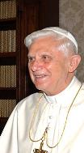
“Always remember that every subject you study is part of a bigger picture.
Never allow yourselves to become narrow.
We need good historians and philosophers economists, but if the account they give of human life is too narrowly focused, they can lead us seriously astray.”
Twickenham Address to Pupils
Notes:
AGAIN…POPE BENEDICT

Slide 50
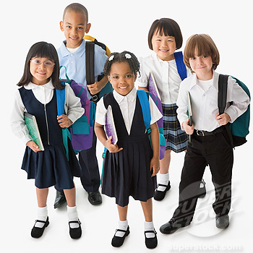
Teaching has an extraordinary moral depth and is one of our most excellent and creative activities, for the teacher does not write on inanimate material but on the very spirits of human beings
The Catholic School on the Threshold of the Third Millennium (Rome 1998) n.19

Slide 51
THIRDLY
What challenge does our
cultural context present?
EXTERNAL & INTERNAL
Notes:
BUT WE DON’T WORK IN A VACCUM…WE ARE IN THIS WORLD AND ITS IMPACT ON US IS PROFOUND…

Slide 52
A task !
In groups of 4, give me
2 adjectives that describe the WORLD
2 adjectives that describe ENGLAND
2 adjectives that describe
TEACHERS
2 adjectives that describe our PUPILS
Notes:
WHAT WE HAVE ARE THE VIEWS OF OVER 30 EDUCATORS – LEADERS IN DIFFERENT AREAS AND FIELDS WHO THROUGH THEIR COLLECTIVE EXPERIENCE SUMMARISE HOW THEY SEE OUR WORLD, DIOCESE AND SCHOOLS AND YOUNG PEOPLE.
NO – THIS IS NOT A SCIENTIFIC EXPERIEMENT…NOT BASED ON ANY SOCIOLOGICAL THEORY…BUT
DO NOT DISMISS THIS COLLECTIVE WOSDOM AND UNDERSTANDING
DO NOT THROW THIS AWAY- TAKE IT FOR WHAT IT IS…
A DIP STICK UNDERSTANDING OF HOW YOU SEE THINGS…BECAUSE WE ARE ALL PART OF THAT WORLD…

Slide 53
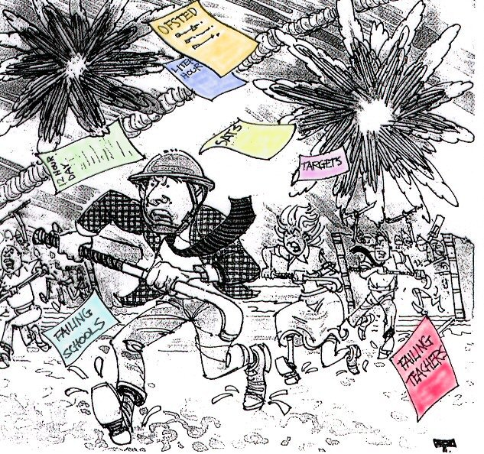

Slide 54
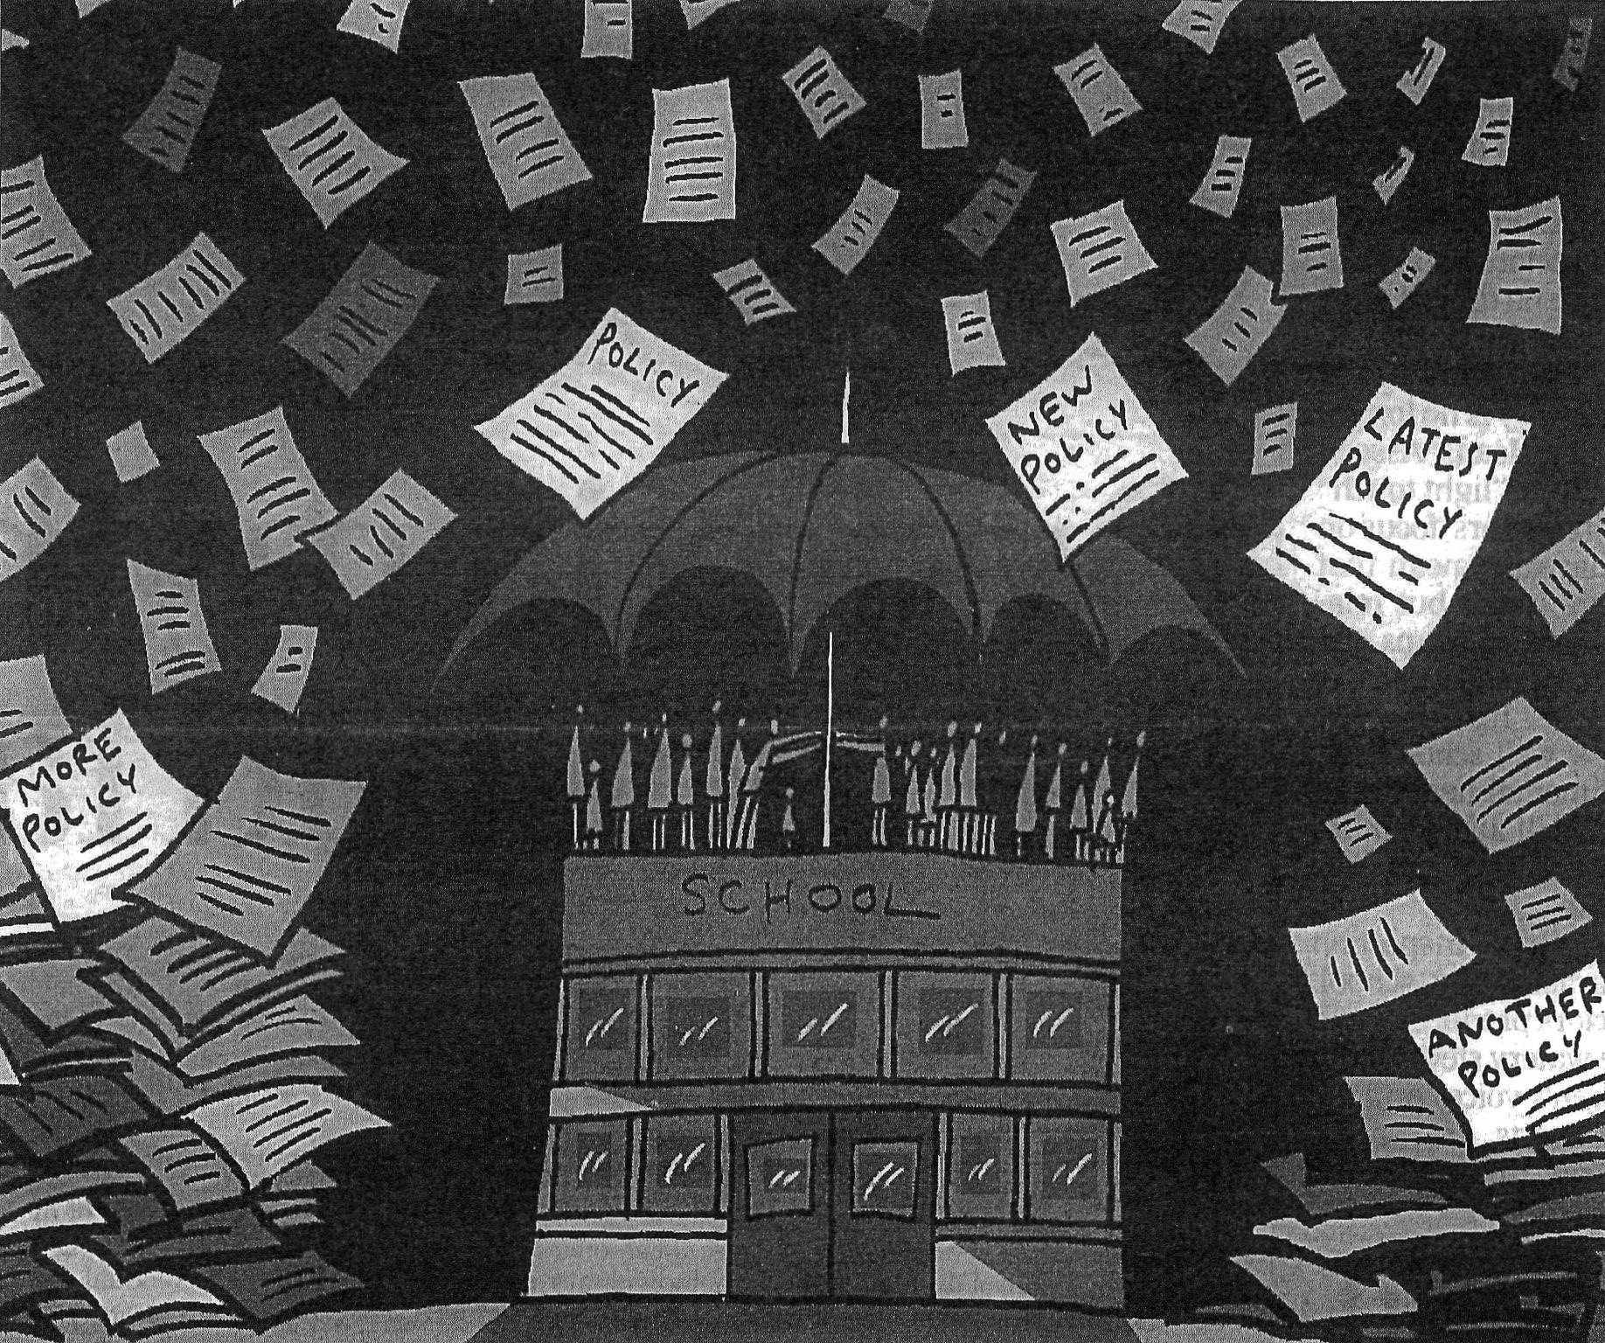

Slide 55

Notes:
Impossible to get on top of things !

Slide 56
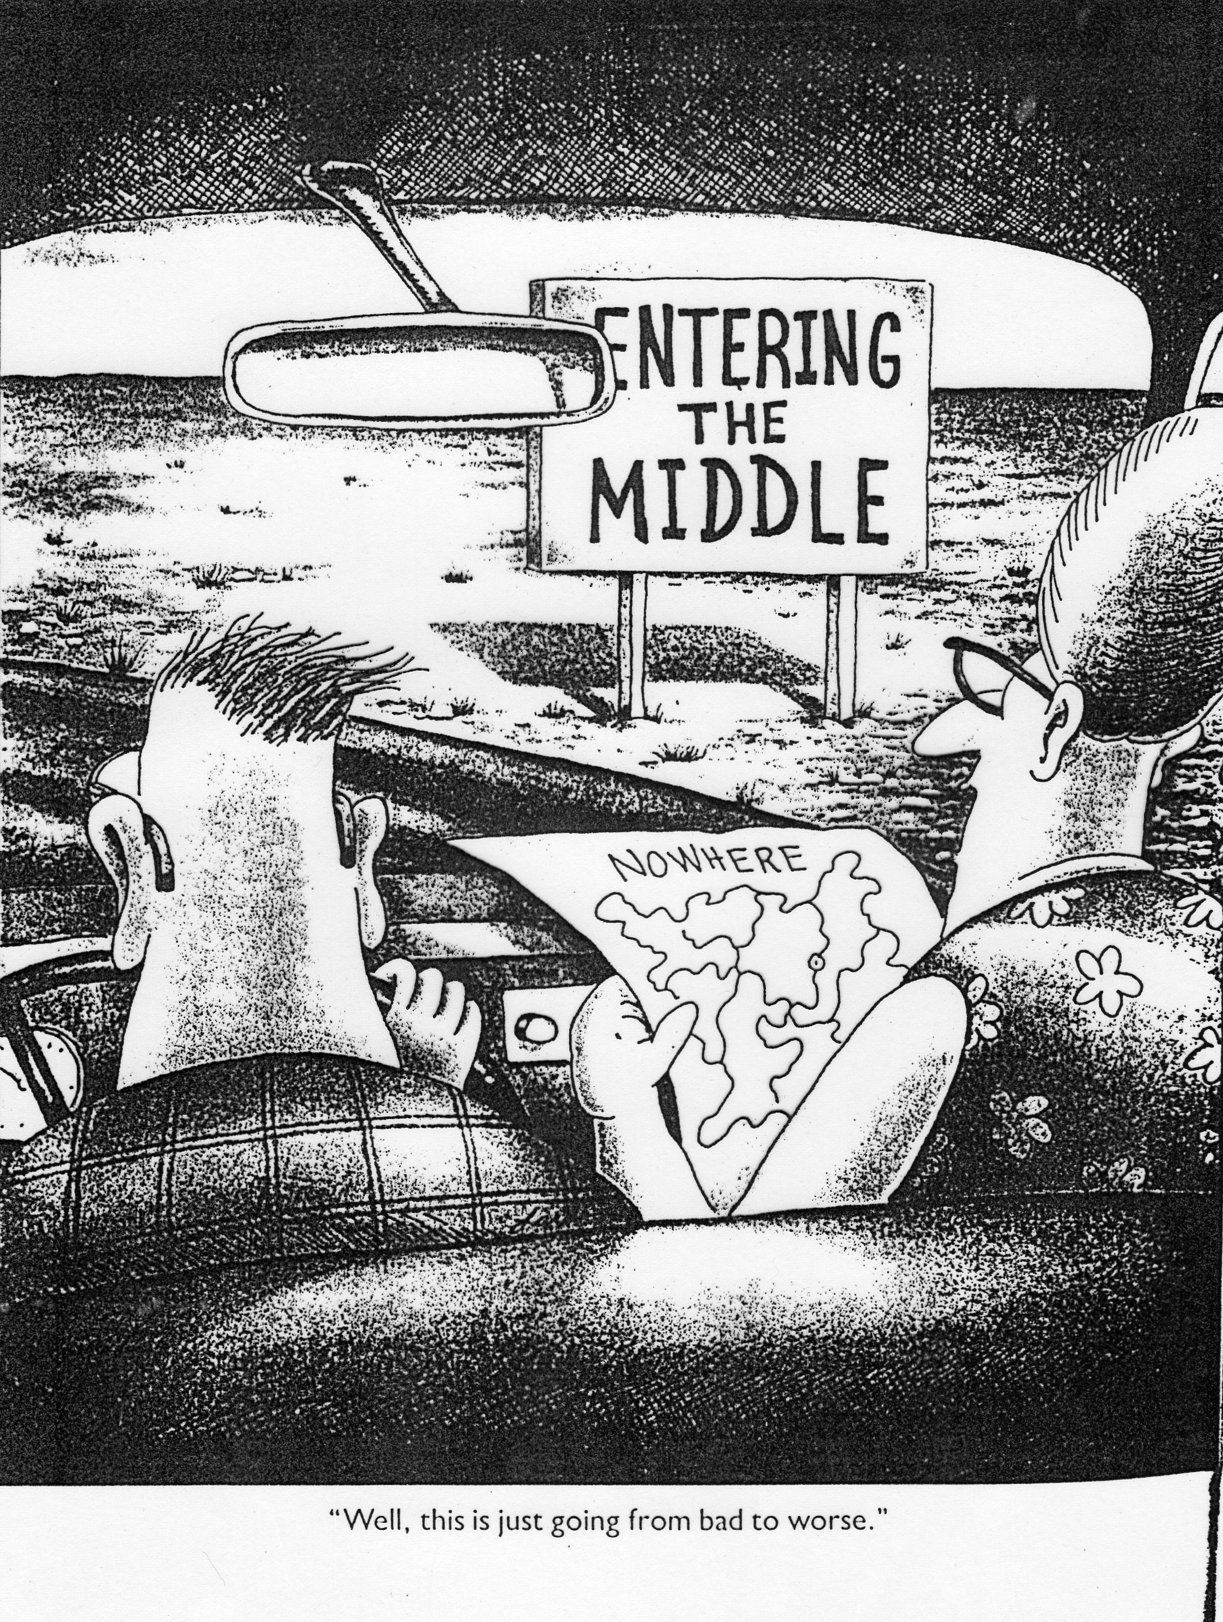

Slide 57
Some of the challenges of ‘our’ culture
Materialism
Image driven
Fractured socially
Relativistic
Individualistic
Social media
Notes:
WE DO NOT LIVE IN A VACUUM… WE LIVE IN A CONTEXT A CULTURE THAT IS CENTRAL TO EVERYTHING WE DO AND THINK…
CULTURE CAN BE DEFINED AS :
“ THE SYSTEMS OF CHARED BELIEFS, VALUES, CUSTOMS, BEHAVIOURS, ARTEFACTS, THAT MEMBERS OF SOCIETY USE TO INTERACT WITH EACH OTHER AND TO INTERPRET AND SHAPE THEIR ENVIRONMENTS’ PAGE 9
ACCORDING TO OUR WORLD:
MY EXPERIENCE IS AS GOOD AS YOURS…it’s all relative….its about what I think, feel, understand, interpret. My truth is as good as your truth
THERE IS NO ABSOLUTE…there is a crisis of authority. My experience becomes my authority. This leads to relativism and also a type of ‘tolerance’ . I cant comment on your lifestyle because it’s yours…and it’s different from mine…that doesn’t make it wrong, it just makes it different .
This breakdown of authority leads to a breakdown of trust…a suspicion of others and anyone who tries to tell us what is right or what to do.
Lets just look at some of the features of the challenges of our culture today.

Slide 58


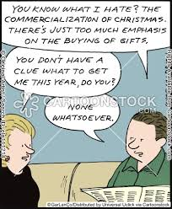

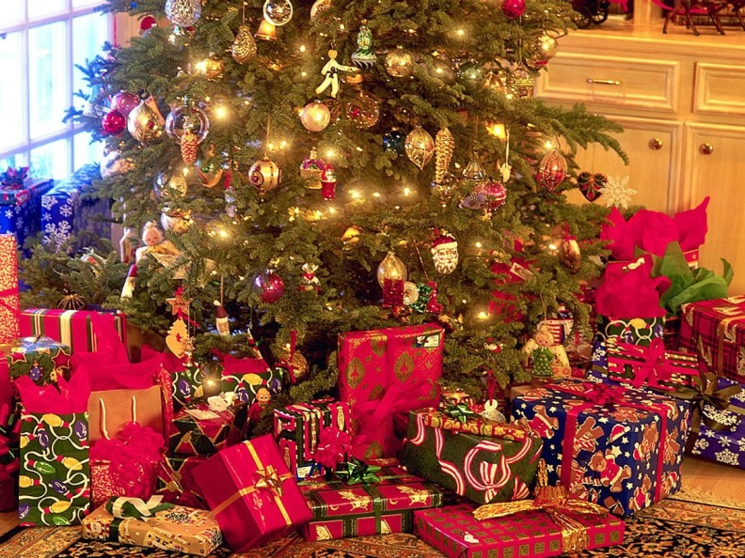
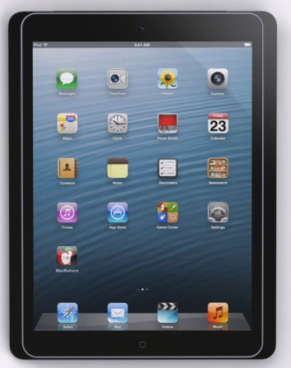

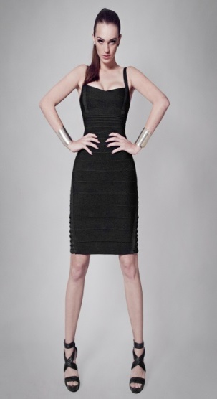
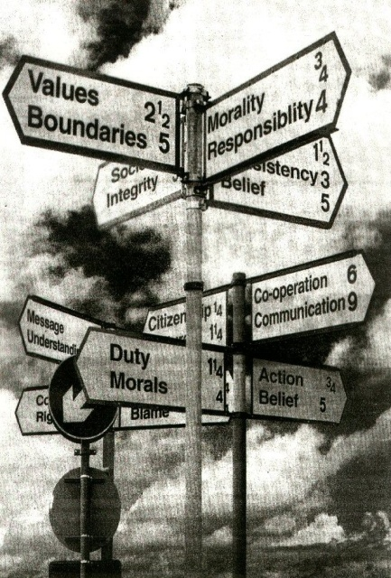
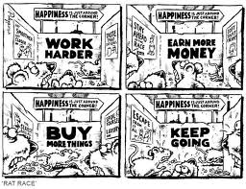
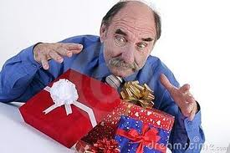
Notes:
Bombarded.

Slide 59
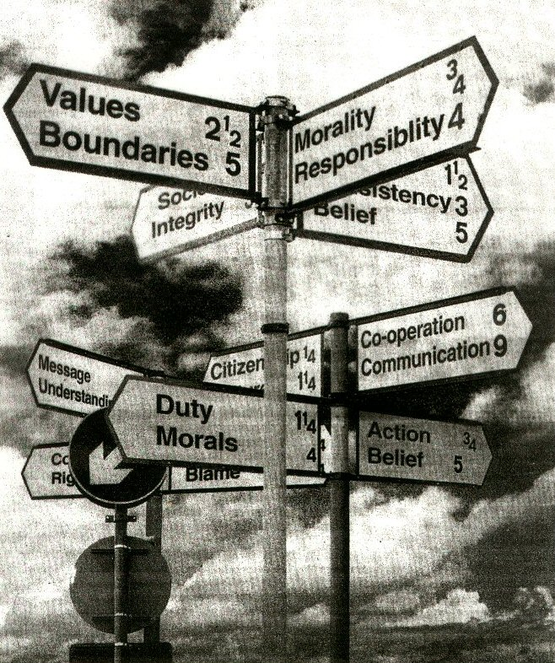

Slide 60
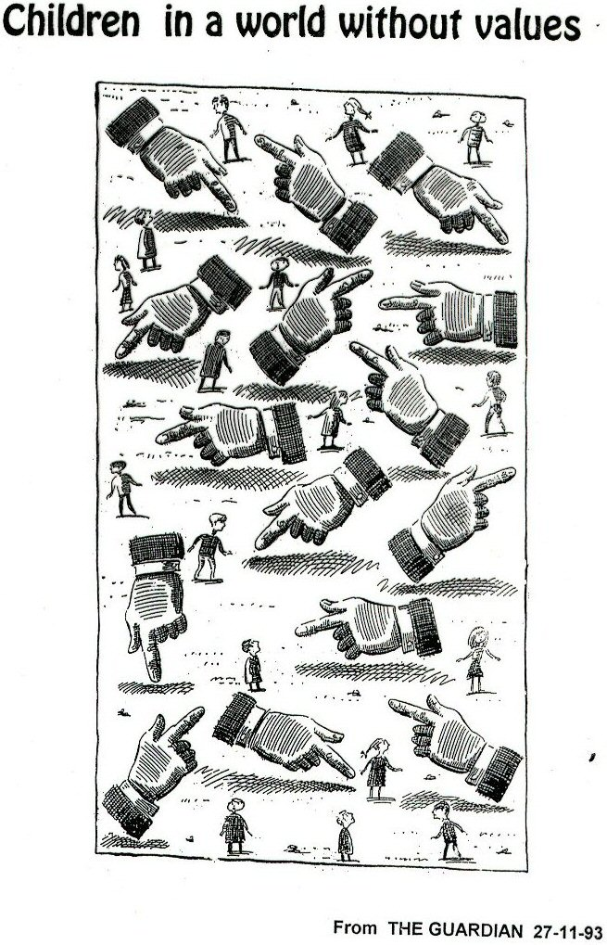

Slide 61
…proclaim the message, in season and out of season…
In what ways does this
‘culture’
impact on your experience as teachers?
Notes:
WE SEEK TO UNDERTSND WHAT IT MEANS TO BE HUMAN IN TERMS OF AND IN RELATION TO JESUS.
THAT’S WHAT MAKES OUR VISION SO DIFFERENT TO THAT FROM OUR CULTURE – WHICH SEES HUMANITY IN TERMS OF WHAT IT MAKES ITSELF AND WHAT GIVES IT MEANING FOR TODAY.
THERE IS NOTHING WRONG WITH OUR MESSAGE – IT IIS A POWERFUL MESSAGE. WE SPEAK WITH THE POWER OF GOD…NAMING THE ANIMALS SO THAT WE WOULD SPEAK RIGHTLY, CALL THINGS BY THEIR PROPER NAMES.
OUR CULTURE HAS CAPTURED RELIGIOUS LANGUAGE AND SYMBOLS AND IMAGERY…JUST LOOK AT DAVID BECKAM WITH THE ROSARY ROUND HIS NECK !
WE ARE OF THIS WORLD – IT IS WITHIN THIS WORLD THAT WE PROCLAIM THE GOOD NEWS…OF WHAT IT MEANS TO BE FULLY HUMAN…
WE MUST CREATE A LIVING LANGAUAGE TO EXPRESS OUR THEOLOGY FOR TODAY.

Slide 62
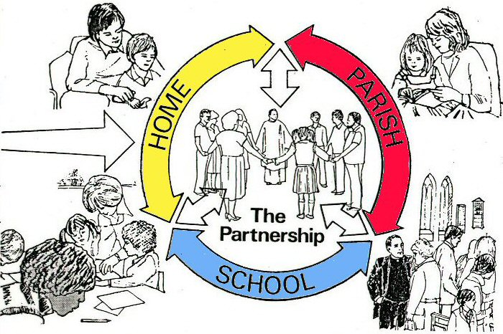
Notes:
YES, IT IS ABOUT A PARTNERSIP – A RELATIONSHIP PARTNERSHIP BETWEEN HOME/SCHOOL AND PARISH.
I MUST ADMIT THAT THIS PARTNERSHIP IS CONSTANTLY UNDER PRESSURE AS MORE AND MORE OF OUR YOUNG PEOPLE DO NOT COME FROM HOMES THAT ARE ACTIVELY INVOLVED IN THEIR PARISHES…LESS SO IN PRIMARY THAN IN SECONDARY SCHOOLS BUT STILL A GROWING CONCERN.
THIS ‘PARISH’ DIMENSION OF OUR EDUCATION IS VITAL FOR US TO BE PART OF AND EXPERIENCE A COMMUNITY OF BELIVERS WHO COME TOGETHER AT JESUS’ COMMEND TO CELEBRATE THE EUCHARIST….
THE SCHOOL CANNOT COMPENSATE FOR PARENTS LACK OF PRACTICE….
WHAT WE CAN DO IS OFFER THE BEST EXPERIENCES AND OPPORTUNITIES WE CAN BUT WE CANNOT REPLACE PARENTS OR PARISH IN THE FAITH DEVELOPMENT AND PRACTICE OF THE FAITH.
TO EACH HIS/HER WON RESPONSIBILITY

Slide 63
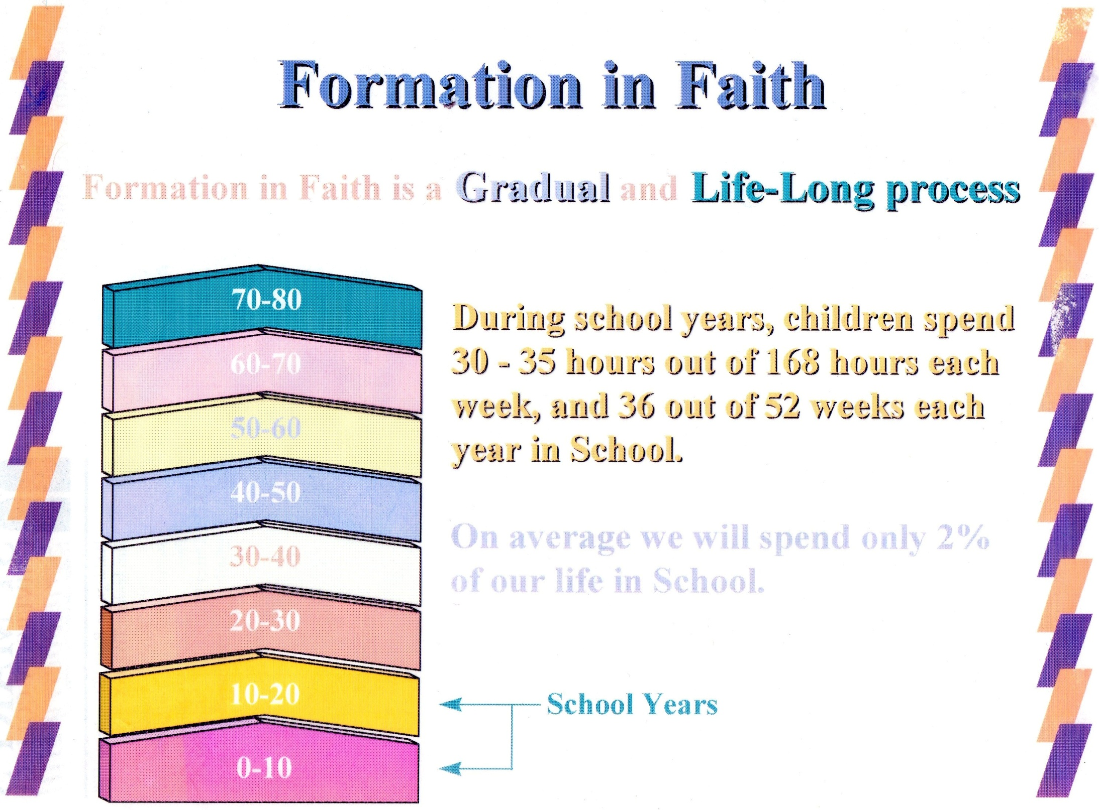
9
Notes:
AND IT IS LIFE-LONG…YOU DON’T HAVE TO DO EVERYTHING ALL AT ONCE…

Slide 64
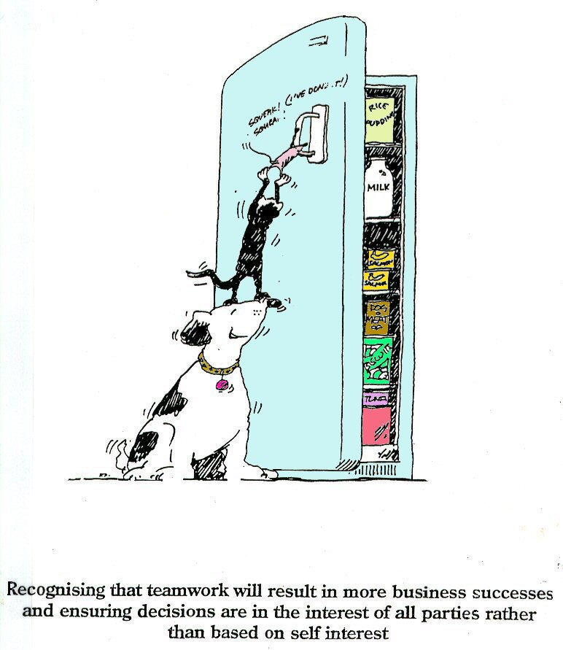
Notes:
It doesn’t matter what role you fill…what function you offer….
What matters is that we have the end in sight….the same goal….the same outcomes in mind….
So, its not just the head…its not just the Catholics…it is me….ME…ME !
AND THE MOST IMPORTANT QUESTION I HAVE FOR YOU THIS MORNING , AS I FINSIH, IS

Slide 65
…have a common purpose
and
a common mind….St Paul

Slide 66
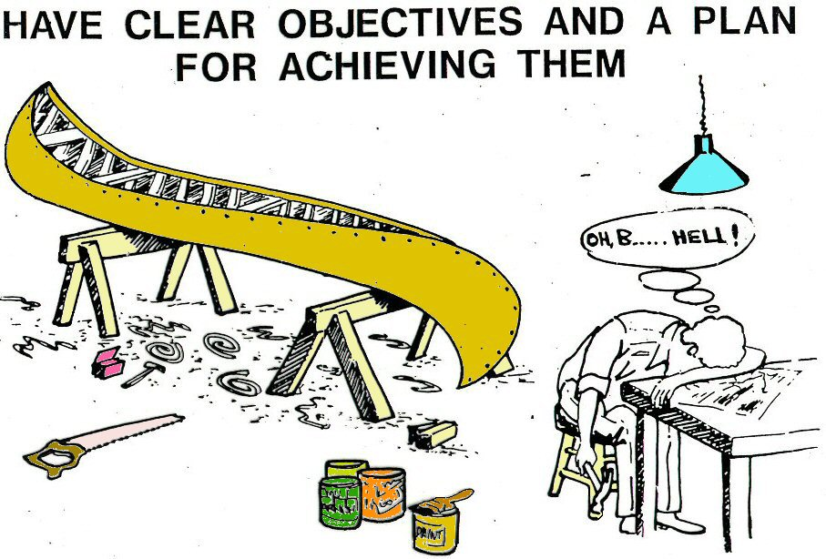

Slide 67
Can we walk together in the same direction ?
Notes:
CAN WE ….
CAN I…
WILL I…

Slide 68
“If our schools are not a space where another humanity is being created, where another wisdom is taking root, where another society is being created, where hope and transcendence have a place, then we are losing out on making a unique contribution to this historical moment.”
Pope Francis
Notes:
THE CONTINUITY OF THE MESSAGE FROM ‘THE CHURCH’ IS EVIDENT IN WHAT POPE FRANCIS HAS SAID RECENTLY

Slide 69
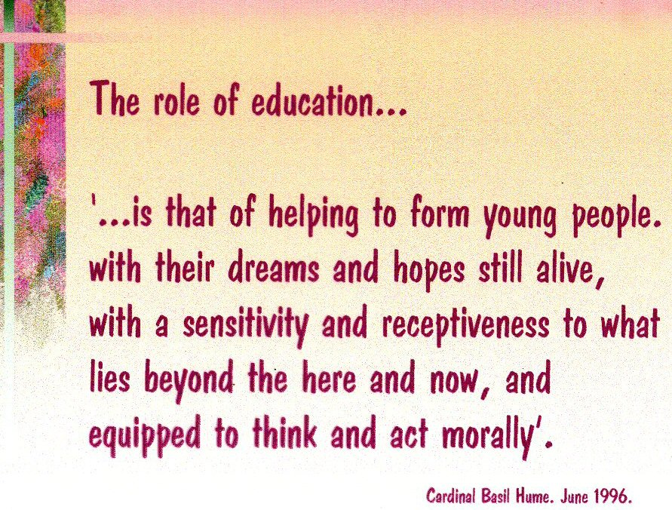
Notes:
AT THE ROOT OF IT ALL….AT THE HEART OF IT ALL…AT THE FOUNDATION OF THE BUILDING….
AT THE CENTRE OF THE JIGSAW IS THE PERSON OF JESUS

Slide 70
SO – how is it in your school ?

Slide 71
IN MY SCHOOL...
Catholic education provides a strong moral compass for pupils 1----------------------------------------1o | Catholic education is about excellence across the curriculum 1------------------------------------------10 | Catholic education teaches the faith 1------------------------------------------10
Catholic education teaches of what lies beneath the surface 1----------------------------------------10 | Catholic education offers a distinctive outlook on life 1----------------------------------------10 | Catholic education values and celebrates differences 1-----------------------------------------10
Prayer makes our Catholic school distinctive from other schools 1----------------------------------------10 | Catholic education is built on the partnership between home, school and parish 1----------------------------------------10 | Catholic education is distinguished by it’s commitment to the Common Good 1------------------------------------------10
Diversity of faith and culture are valued and celebrated in our school 1----------------------------------------10 | Religious education has a safeguarded place and time on the curriculum 1----------------------------------------10 | Catholic education in our school is inclusive 1-------------------------------------------10

Slide 72
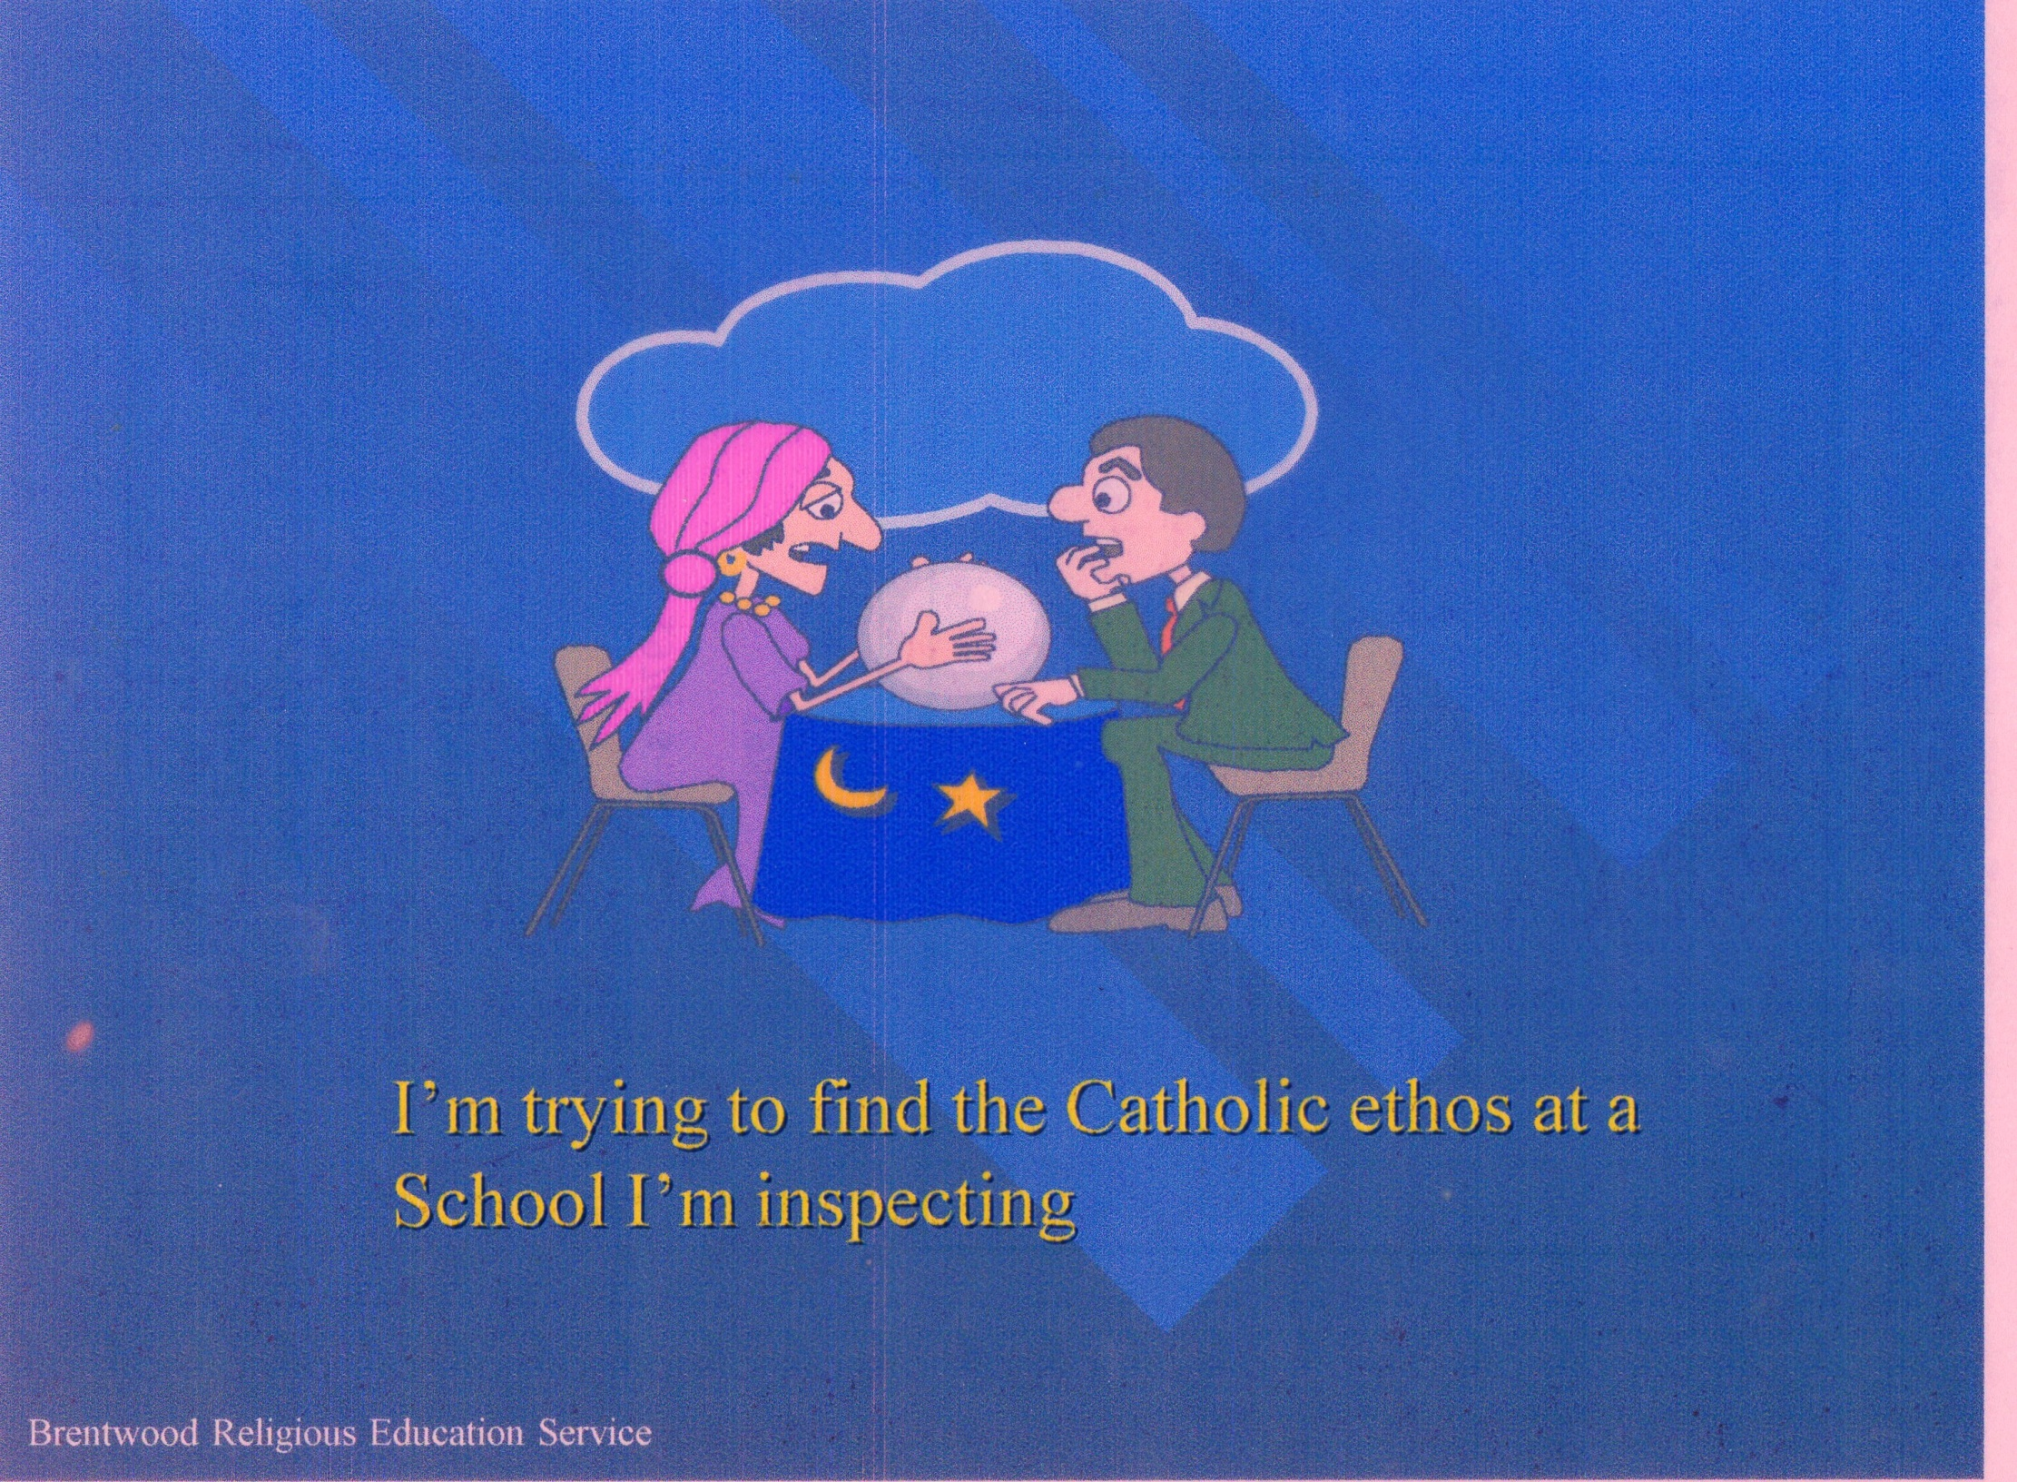
Notes:
IIT MUST NEVER BE CRYSTAL BALL GAZING !!

Slide 73
FOURTHLY
Leading ... from the back...the middle... the front!!

Slide 74
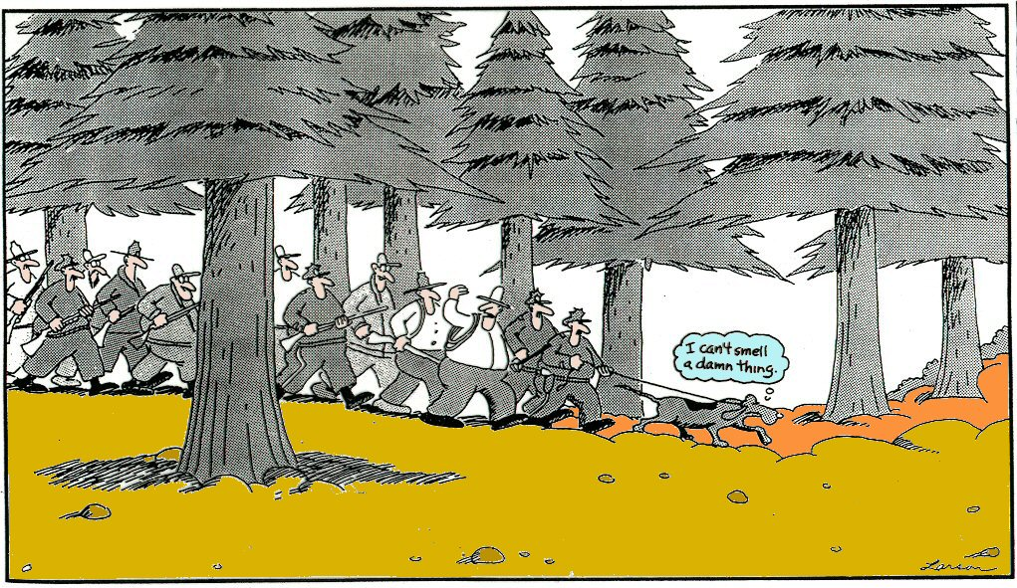
Notes:
IF YOU DON’T KNOW WHERE YOU’RE GOING…WHAT HOPE IS THERE !!

Slide 75
What are some of the most important things
you do in Catholic education…?
What are some of the most difficult things you have to do?
Notes:
CAN WE ….
CAN I…
WILL I…

Slide 76
Leadership
I wanna be the leader
I wanna be the leader
Can I be the leader?
Can I? I can?
Promise? Promise?
Yippee I'm the leader
I'm the leader.
OK what shall we do then !!?
The Leader by Roger McGough
(Poems on the Underground)

Slide 77
It’s about how you will work together…and enabling everyone to contribute…

Slide 78
Leadership is about…
INSPIRING a shared vision…and articulating it.
ENABLING others to act…by ensuring that staff have the structures to operate efficiently and effectively.
MODELLING the way…walking with others, alongside them, collaboratively.
ENCOURAGING the heart…giving trust and inspiring trust.

Slide 79
Its about being clear about our outcomes ….its about the STRATEGIC DIRECTION
of all schools!

Slide 81
…have a common purpose
and
a common mind….St Paul
Notes:
We need to interpret reality = THAT IS THE ROLE OF CATHOLIC LEADERS….
WE NEED TO FORM OURSELVES IN ORDER TO FORM OTHERS….

Slide 82
KEY QUESTIONS FOR LEADERSHIP
MISSION
What is our mission/purpose/ultimate goal?
What empowers/energies us?
Who takes responsibility?
POWER
STRUCTURES
How are we/ should we be organised
To accomplish the mission?
What do we HAVE that
We can use to accomplish the mission;
What do we NEED?
RESOURCES

Slide 83
“… without exception, the most important single factor in the success of these schools is the quality of the leadership...”
The Good Schools HMI Report.
Northern Ireland
Notes:
FROM WITHIN THE CHRISTIAN CATHOLIC TRADITION, JESUS OFFERS A VISION OF LEADERSHIP THAT CHALLENGES NORMAL UNDERSTANDING AND EXPECTATION.
TO UNDERSTAND HIS VISION, WE NEED TO KNOW HIM….
MY VISION OF CATHOLIC EDUCATION IS BUILT UPON HAVING AND SHARING A VISION…YOU HAVE TREMENDOUS POWER – influence, clout, muscle, sway…
MANY PEOPLE IN OUR EDUCATIONAL WORLD HAVE POWER TO LEGISLATE, DIRECT AND EFFECT CHANGE IN SCHOOLS
POWER IS KEY IN ANY ORGANISATION. IT CAN EMPORWE OTHERS OR CONTROL AND MANIPULATE THEM. IT SEEMS TO ME THAT THE POWER THAT EMANATES FROM GOVERNMENT IS ABOUT CONTROL AND PRESSURE…THAT IS HOW IT IS PERCEIVED AND RECEIVED.
IT IS THE TONE, THE CHANGES, THE WAYS THINGS ARE BEING DONE TO US !
IN THE CHIRSTIAN SENSE, POWER IS SERVICE…ENABLING…ENCOURAGING…CHALLENGING…

Slide 84
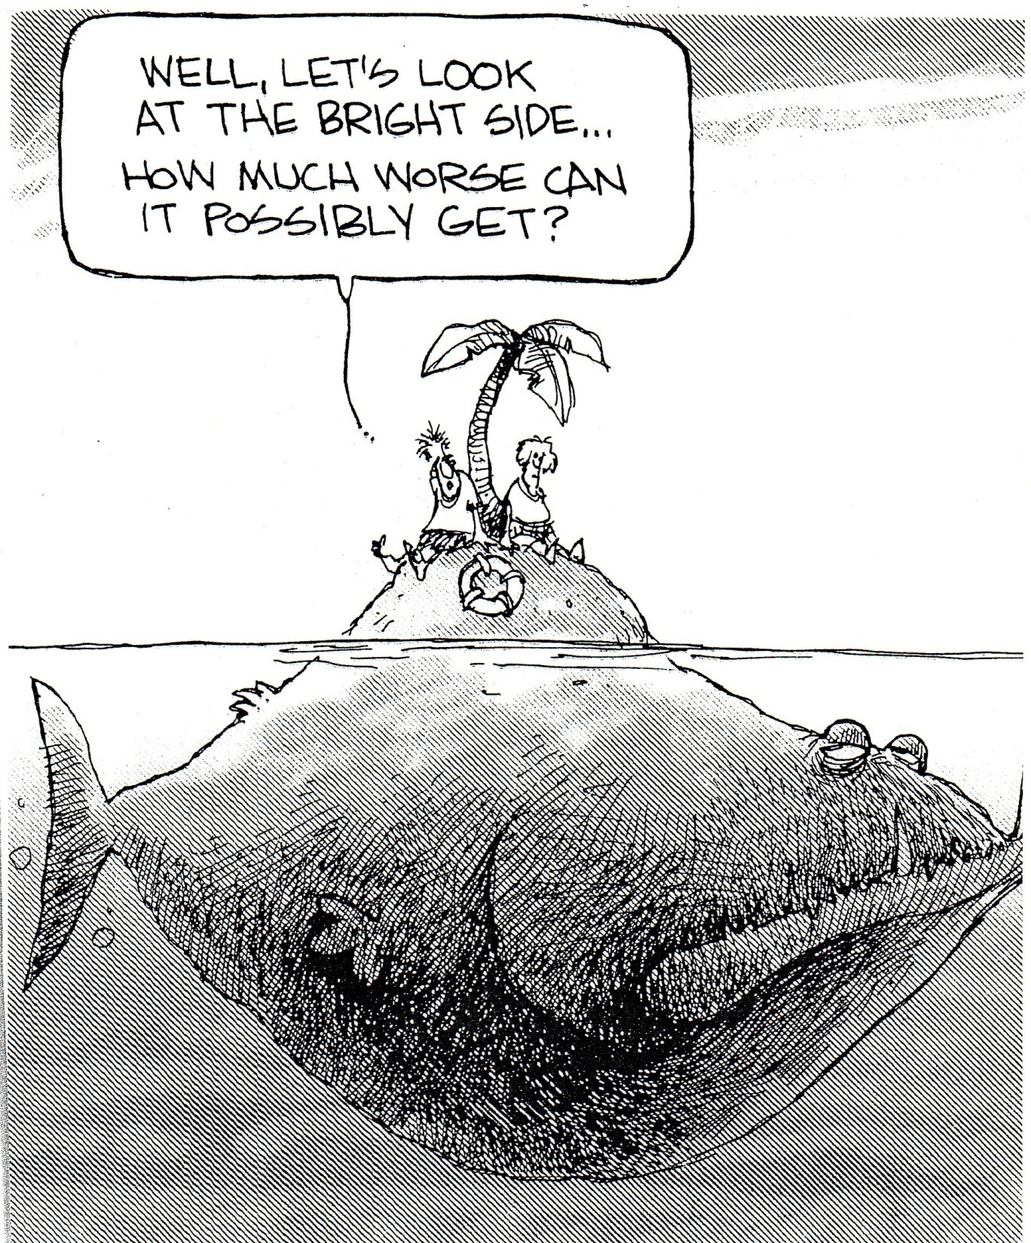

Slide 85
Notes:
AND AT THE END OF IT…WHAT WE HOPE FOR…

Slide 86
“ You are part of a building that has the apostles
and prophets for its foundation
and Christ Jesus himself for its main cornerstone…”
Ephesians 2:20.
Notes:
ONE TREAUSRE ONLY, THE LORD, THE CHRIST – IT IS FAITH IN JESUS, CELEBRATED AND EXPERIENCED THROUGH THE RICHNESS OF OUR CHURCH, THAT IS THE MESSAGE AND THE REALITY AND THE CHALLENGE AND THE PRIVILEGE.

Slide 87
Summary
God at the heart of all things
  Touched, tasted, heard, smelt and spoken
A vision of the human person
  visionary; sacramental; relational; transformational
Experienced through all aspects of the daily life of the school
  vision into reality

Slide 88
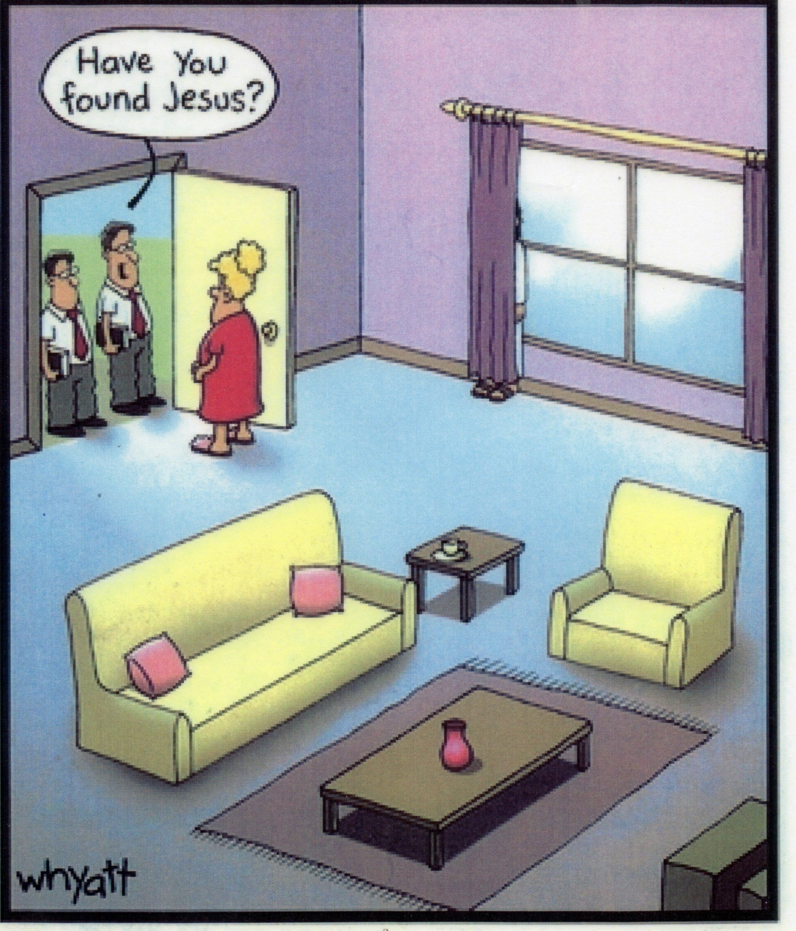
Notes:
LET’S NOT HIDE JESUS….
THIS IS OUR TREASURE….

Slide 89
“If our schools are not a space where another humanity is being created, where another wisdom is taking root, where another society is being created, where hope and transcendence have a place, then we are losing out on making a unique contribution to this historical moment.”
Pope Francis
What ONE thing said, heard, reflected upon, will actually make a difference to you and to your ministry as missionaries of the Gospel?
2. What ONE thing might you actually DO !!?

Slide 90
Resources
Clashing Symbols. Michael Paul Gallagher SJ. Darton, Longman & Todd. 1997. Amazon
The People wish to see Jesus – reflections for those who teach. Pope Francis. Crossroad publishing Co. 2014
Education for choosing life – proposals for difficult times. Pope Francis.

Slide 91
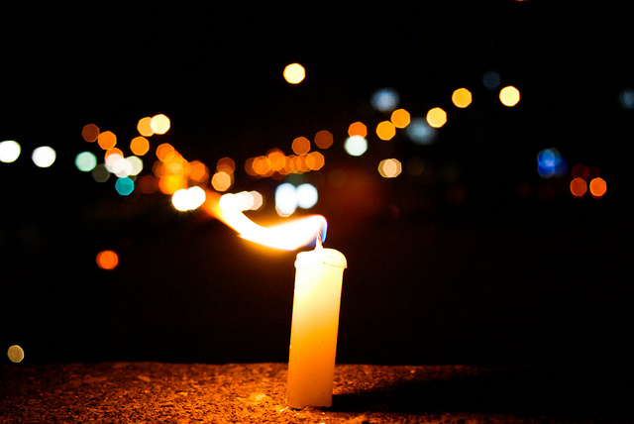
Chosen to lead Christian learning communities in the 21st Century
In challenging and demanding times!

Slide 92
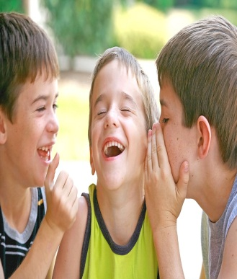

In this 21st Century….
Society will want them to make the best of their lives
But who, but you, will transform their lives for ever?

Slide 93

In 21st Century….
Society tells them life is fleeting,
pleasure is instant
Who, but you,
will lead them to life eternal
and the Joy of the Gospels?

Slide 94
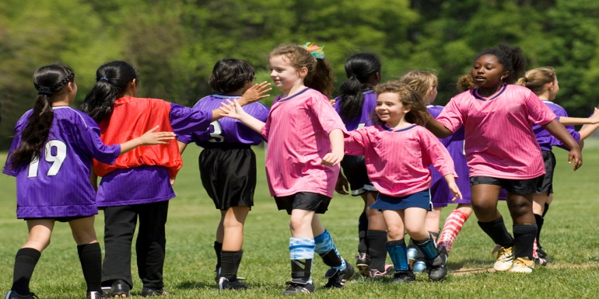
In 21st Century….
Society tells them winners take all
Who, but you,
will teach them the power of the Beatitudes?

Slide 95
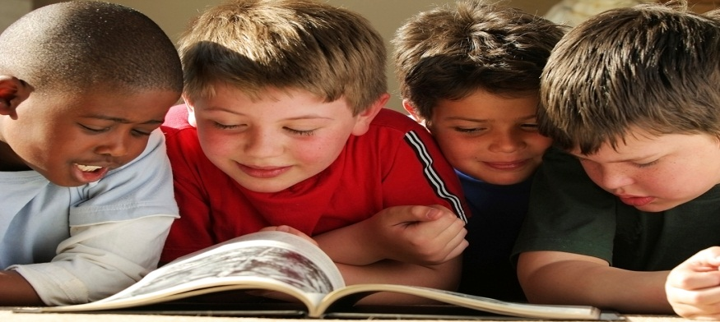
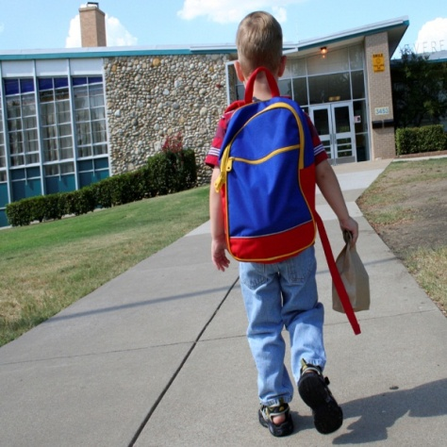
In 21st Century….
Society will persuade them to purchase and to consume
and ‘reward’ them with ownership and possessions !!!!
Who, but you, will lead them to realise the values
of Christian virtue?

Slide 96


In 21st Century….
Society will tell them to become celebrities
Who else, but you, will lead them to be Saints!!

Slide 97
“When I invite you to become saints,
I am asking you not to be content with second best.
I am asking you not to pursue one limited goal
and ignore all the others.
Having money makes it possible to be generous and to do good in the world,
but on its own, it is not enough to make us happy.
Being highly skilled in some activity or profession is good,
but it will not satisfy us unless we aim for something greater still.
It might make us famous, but it will not make us happy.
Happiness is something we all want,
but one of the great tragedies in this world is that so many people never find it, because they look for it in the wrong places.
The key to it is very simple –
true happiness is to be found in God.”
Pope Benedict XVI to Pupils 17th September
Twickenham: Address to Pupils
Notes:
AND IF YOU WANT TO MEASURE SUCCESS ----
SUCCESS WILL,
BE UNDERSTOOD IN REALTION TO THE OPPORTUNITIES OFFERED AND TAKEN TO EXPAND PUOILS SENSE OF WHAT IT MEANS TO BE HUMAN.
IN A WORLD THAT MEASURES SUCCESS / QUALITY/ EXCELLENCE IN TERMS OF
POWER,
POSSESSION
PASSION
SELF
WE MEASURE QULAITY AND EXCELLENCE IN TERMS OF PROVIDING OUR YOUNG PEOPLE WITH
‘REASONS FOR LIVING AND HOPING'

