Slide 1
13th March 2017
Do not judge,
and you will not be judged
Luke 6:37
Notes:
Monday, March 13th, 2017
Luke 6:37
Do not judge, and you will not be judged

Slide 2
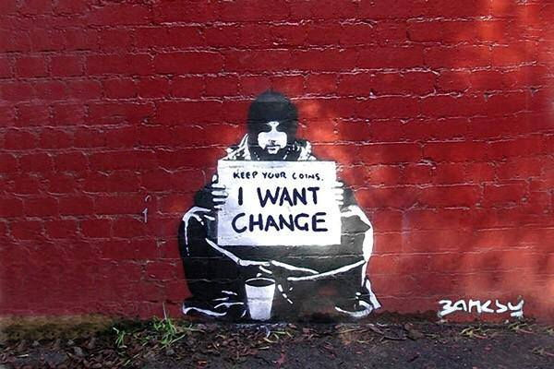
‘Learn to do good’
14th March 2017 Isaiah 1:17
Notes:
Tuesday, March 14th, 2017
Isaiah 1:17
Learn to do good

Slide 3
YOU ARE MY
15th March 2017
GOD
Psalms 31:5
Notes:
Wednesday, March 15th, 2017
Psalms 31:5
'You are my God,'

Slide 4
‘Blessed is anyone who trusts in the Lord’
Jeremiah 17:7
16th March 2017
Notes:
Thursday, March 16th, 2017
Jeremiah 17:7
'Blessed is anyone who trusts in the Lord’

Slide 5
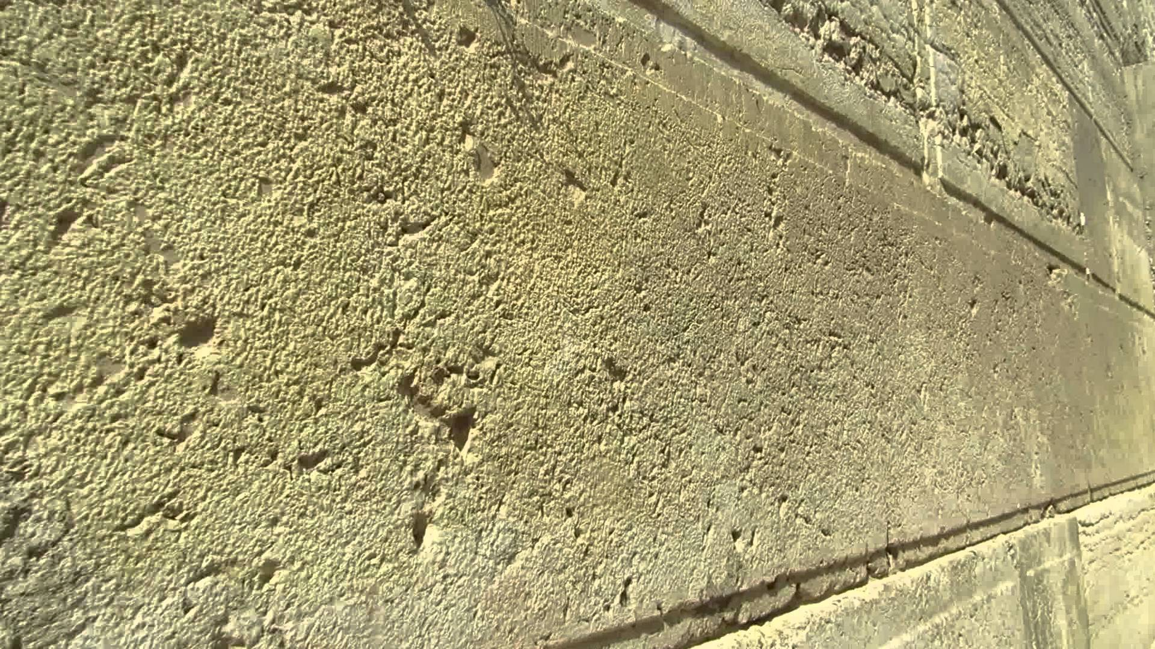
The stone that the builders rejected
has become the cornerstone.
Matthew 21:42 17th March 2017
Notes:
Friday, March 17th, 2017
Matthew 21:42
The stone which the builders rejected has become the cornerstone

