Slide 1
Why
this
does
13-02-17
Mark 8:12
?
generation
a
sign
demand
catsc.org
Notes:
13th Feb 2017
Mark 8:12
Why does this generation demand a sign?

Slide 2
LOVE IS PATIENT
love is kind
love is not jealous
IT IS NOT
or boastful
ARROGANT
believes all
OR RUDE
things
St. Valentine’s Day 2017
LOVE BEARS ALL THINGS
HOPES
endures all things
all things
LOVE NEVER ENDS
1 Corinthians

Slide 3
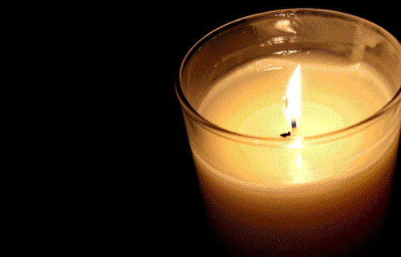
www.catsc.org
15th Feb 2017
There is a light that never goes out.
Catholic Association Of Teachers, Schools and Colleges

Slide 4
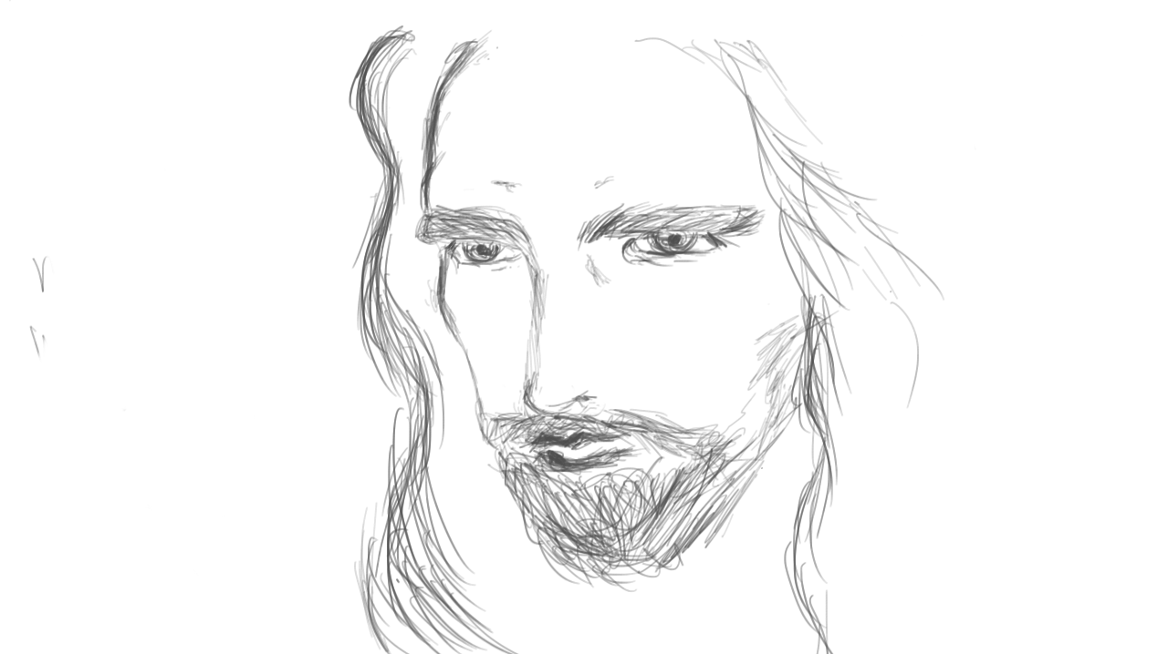
16th Feb 2017
Mark 8:29
'You are the Christ.'
Notes:
16th Feb 2017
Mark 8:29
'You are the Christ.'

Slide 5
The whole
Genesis 11:1
world
spoke the
same
language
17th Feb 2017
Notes:
The whole world spoke the same language

