Slide 1
I will shower
blessings on you.
www.catsc.org

Slide 2
King of Peace
Hebrews 7:2
www.catsc.org

Slide 3
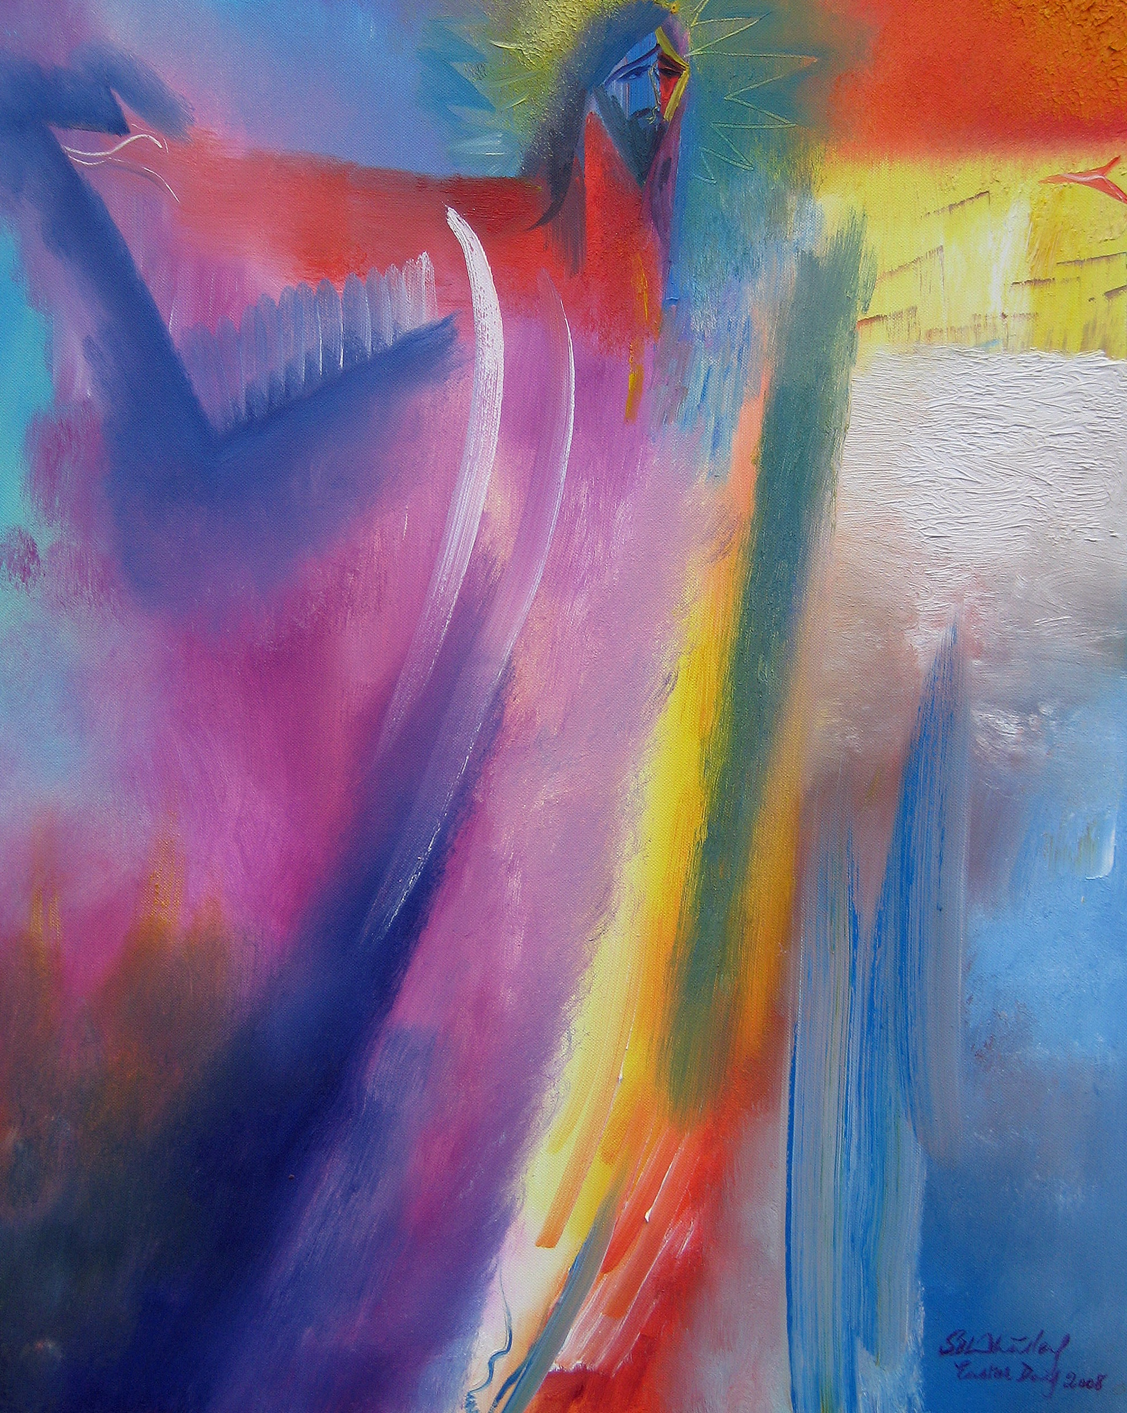
Mark 3:11
'You are the Son of God!'
www. catsc.org

Slide 4
Catholic Association of Teachers, Schools and Colleges
“His glory will dwell in our land” Psalms 85:9
Notes:
his glory will dwell in our land

